Slide 1
‘A HISTORICAL CRITIQUE OF ISLAM’
Assessing the newest research on the historical Problems with Islam’s Origins
By Dr. Jay Smith
CIRA International
October 14, 2022

Slide 2
4 areas we must investigate…
[1] THE PROBLEM WITH THE SOURCES
[2] THE PROBLEM WITH MECCA
[3] THE PROBLEM WITH EARLY ISLAM
[4] THE PROBLEM WITH THE QUR’AN

Slide 3
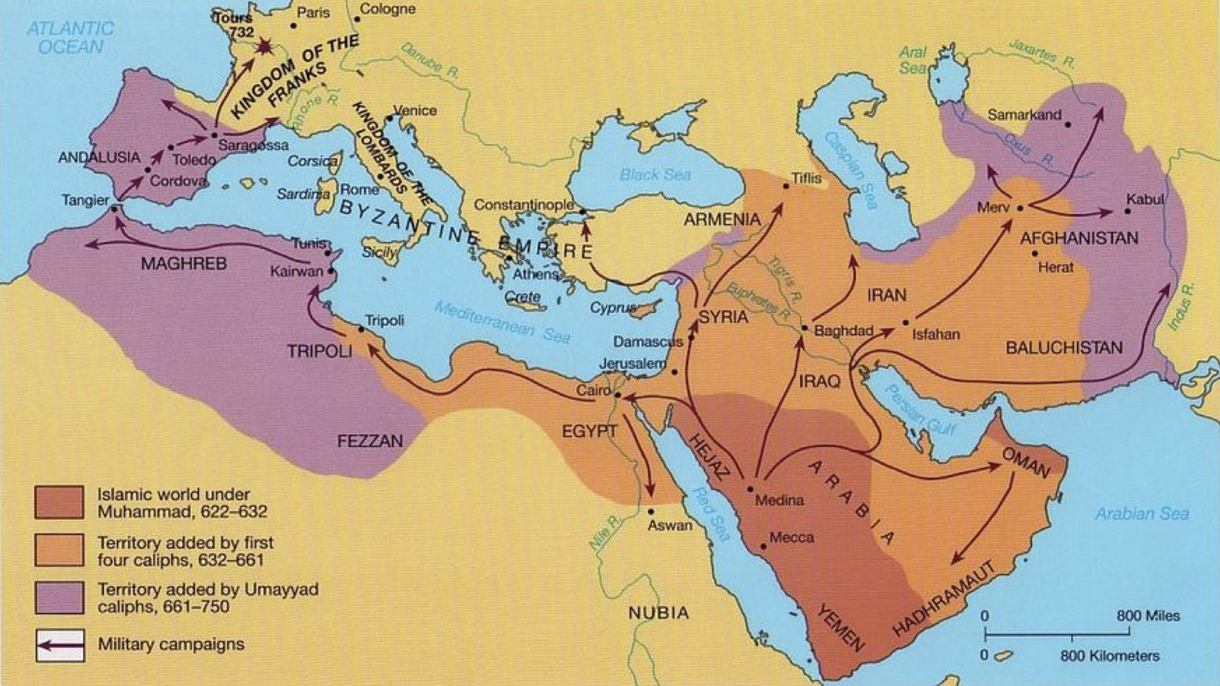
Islam’s early Expansion
The Umayyad Dynasty
(661-750 AD)
The ‘Rushidun Period’
(632-661 AD)
Muhammad’s Empire (632 AD)
According to the ‘Standard Islamic Narrative’

Slide 4

Ali
656 - 661
A Timeline of Islam’s Emergence (according to the “SIN”)
Uthman
644 - 656
Conclusion: Islam was fully formed, in the Hijaz, by 661 AD!
Umar
634 - 644
Abu Bakr 632 - 634
Muhammad dies 632
Mecca 630
Qur’an compiled 652
Muhammad is born 570
The Qur’an is first revealed 610
Hijra
622
Mi’raj
621
570
576
582
588
594
600
606
612
618
624
630
636
642
648
654
660
Muhammad’s life
Question: How do we know all of the above? Where does it come from?

Slide 5

Sources for the ‘ISLAMIC TRADITIONS’ (SIN)
Sira = Biography of Muhammad
Hadith = Sayings of Muhammad
Tafsir = Commentaries on the Qur’an
Tarikh = Histories of Mankind
Ibn Hisham (d.833 AD)
Al Waqidi (d.835 AD)
Muhammad dies 632 AD
Al Bukhari (d.870 AD)
Sahih Muslim (d.875 AD)
At-Tirmidhi (d.884 AD)
Ibn Majah (d.887 AD)
Abu Dawud (d.899 AD)
201 YEARS
An-Nisa’i (d.915 AD)
Abbasids
(749 AD)
84 YEARS
Al Tabari
(d. 923 AD)
Ibn Ishaq (d. 765 AD)
632
652
670
690
710
730
750
770
790
810
830
850
870
890
910
930

Slide 6
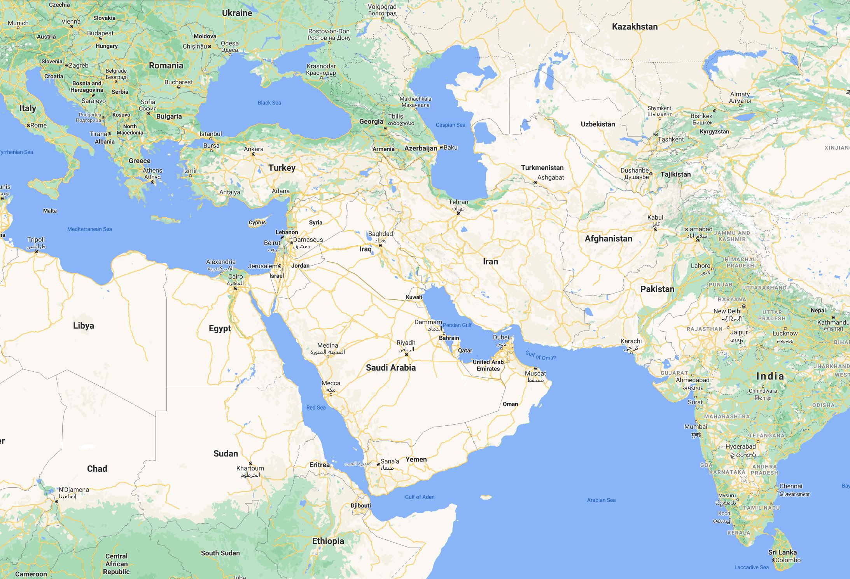
The problem of a Northern Hegemony
The Islamic Traditions say everything happened in Mecca and Medina (the Hejaz)
Bukhara
Yet, all of the writers of the Traditions worked in Baghdad, which is 1,120 mi. too far north
Baghdad
Tabaristan
Cairo
Basra
NOTE: All of these northern areas are where the Abbasids originated from
Medina
Furthermore, all of the writers of the Traditions worked in the 9th and 10th centuries
Mecca
CONCLUSION: They all wrote their material hundreds of miles too far away, and hundreds of years too late!
632
652
670
690
710
730
750
770
790
810
830
850
870
890
910
930
201 YEARS
Al Tabari
(d. 923 AD)
Al Bukhari (d.870 AD)
Muhammad dies 632 AD
Ibn Hisham (d.833 AD)

Slide 7
John
(Sira & Hadith)
90 AD
(57 years)
Christianity’s Emergence, according to our “Traditions”
Note: Most scholars would put the dates for the books of the New Testament in this timeline much earlier. We are using the latest possible dates, to make our point clearer
Matthew & Luke
(Sira & Hadith)
80 AD
(47 years)
Mark
(Sira & Hadith)
70 AD
(37 years)
Paul’s letters (Tafsir)
48 – 65 AD
(15 – 34 years)
Book of Acts (Tahrikh)
52 – 62 AD
(20 – 30 years)
Jesus Dies
33 AD
33 AD
37
41
45
49
53
57
61
65
69
72
76
80
84
88
92
Within 29 – 57 years of Christ’s death for the whole N.T.
Note: All of the New Testament writers lived in the same place Jesus lived, and they either knew him personally, or they got their material from others who saw what he did, and heard what he said

Slide 8
Comparing Christianity vs Islam
When were the earliest biographies and sayings for both faiths written?
Christianity 15 – 60 years later, written by those from the same area
Islam 200 – 300 years later, hundreds of miles too far north
Which would you guess is more authoritative?
As a comparison: If we had to depend on sources for Jesus, comparable to what Muslims are dependent on for Muhammad, Jesus would not begin to appear until the 3rd century!

Slide 9
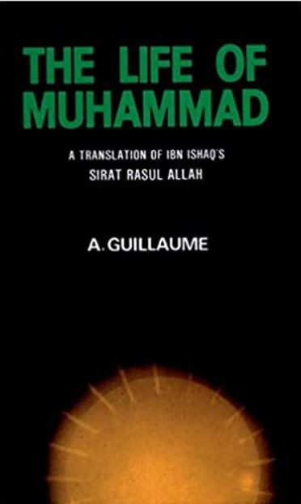
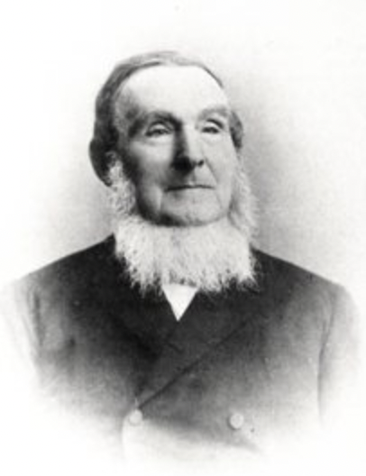
Who created the Sira?
Alfred Guillaume, taken from Ibn Ishaq?
No, there was nothing about Muhammad’s life up to 1819 AD
It was Heinrich Ferdinand Wustenfeld (1808 – 1899), who between 1858 – 1860 compiled the Sira
Taken from libraries and museums in 4 German cities
Then translated by Guillaume and others later
In 1967 Fouad Sezgin compiled another Sira from documents found in Morocco

Slide 10
21st Century Scholar’s Conclusions
Concerning these late dates…
“Islam, as we know it, did not exist in the 7th century, but evolved over a period of 200-300 years” (Humphreys 1991:71,83-89)
“The Qur’an probably was not revealed to one man in 22 years, but likely evolved over a period of 50-100 years” (Rippin 1985:155;1990:3,25,60; Lester 99:44-45; Wansbrough 1977:160-163)
Conclusion: The history of Islam, at least from the time of the caliph Abd al-Malik (685-705 AD) and before, is a later fabrication (Cook 1983:65, Robinson 1996:47)

Slide 11
2) THE PROBLEMS WITH MECCA
Mecca is all through the “SIN”!

Slide 12
Why Mecca?
Mecca is where everything in Islam happened
Therefore, the Book and the Man are absolutely dependent on Mecca
If it didn’t exist, then neither did the other two
Once you get rid of Mecca in the 7th century, then you get rid of Muhammad and the Qur’an in the 7th century, at least the Muhammad and the Qur’an of Islam…

Slide 13
What Muslims Claim
MECCA is the oldest and best-known city in history
Mecca is where Adam and Eve were thrown down to, from the Garden of Eden (Surah 7:24)
Mecca is where Abraham lived when he destroyed the idols within the Ka’aba (Surah 21:51-71)
Mecca is the center of trade North, South, East and West (Montgomery Watt’s ‘Trade Route Theory’)
So, it should be one of the best known and best documented places in history!

Slide 14
Inferences to ‘Mecca’ in the Qur’an
Mecca is the center of Islam, and the center of history
(Note: none of the verses below use the word “Mecca“. It‘s only implied)
“The first sanctuary appointed for mankind was that at Bakkah (Mecca)”? (Sura 3:96)
Mecca is the “mother of all settlements.” (Sura 6:92 & 42:7)
Mecca was where Adam & Eve were caste down to (Sura 7:24)
Mecca was where Abraham lived in 1900 BC (Sura 21:51-71)
Mecca was where Muhammad was born and lived until 622
Mecca became the center for the Qibla in 624 (Sura 2:149-150)
The above imply people have lived there from the very beginning
Yet, the only reference to ‘Mecca’ in the Qur’an is in Sura 48:24…Why, if it is so important?

Slide 15
It has much vegetation (thus, it has water)!
According to the Qur’an and the Traditions:
Mecca is referred to as `The Place of the Prophet’
In a valley, & parallel valley (Ibn Hisham; Al Bukhari 2:645, 2:685, 3:891, 2:815, 2:820, 4:227)
With a stream (Al Bukhari 2:685)
Outside is the ruins, and a pillar of ‘salt’ (Surah 37:133-138)
With fields (Al Bukhari 9:337)
Has Trees (Sahih al-Tirmidhi 1535), Grass (al Bukhari 9:337), fruit (Al Bukhari 4:281), Clay and Loam (Al Tabari VI 1079 p.6)
Has ‘Olive Trees’ (Surah 6:141; Surah 16; Surah 80)
With Mountains overlooking the Kaa’ba (Ibn Hisham; Al Bukhari 2:645, 2:685, 3:891, 2:815, 2:820, 4:227)
Yet, Mecca is not in a valley, and has none of these listed above, because it is in a DESERT, so it’s just too arid and dry to support any of the above!

Slide 16
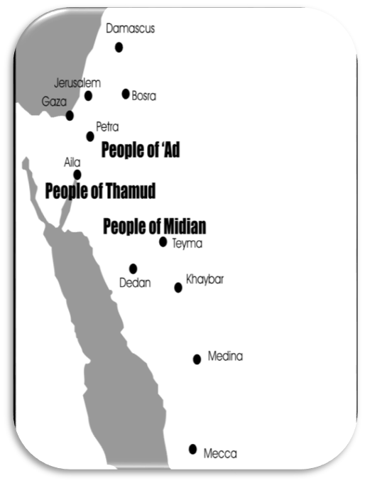
Notice where the Qur’an positions its narrative
The Qur’an has just 65 Geographical references!
Only 9 places named, mostly referring to people
  - ‘Ad (23x) (Biblical ‘Uz)
  - Thamud (24x) (Nabateans)
    Cut dwellings into mountains
  - Midian (7x) (Midianites)
    They must be important
    Yet, all 3 civilisations are located
    in Northern Arabia and not near MECCA!
600 miles too far NORTH!

Slide 17
Note the Prophets who were buried in Mecca
Adam and Eve
Seth
Ishmael
Noah
Hud (great-great grandson of Noah)
Salih (grandfather of Hagar)
Queen of Shebah
Daniel
70 – 300 other prophets
All lived or died, and were buried (kneeling) in Mecca, so why can’t we find them?
This would mean that almost all of the Bible would have to be re-written, and all of the stories be re-directed 600 miles further south
Yet, there is so much evidence for the Biblical narrative historically, yet almost nothing for Islam’s

Slide 18
Earliest literary reference to Mecca’s existence: Apocalypse of Pseudo-Methodius Continuatio Byzantia Arabica
During the early reign of caliph Hisham
- 741 AD!
- The earliest maps don’t show MECCA until…. 900 AD!
  Cröne: Greek trading documents refer to the towns of Ta’if (South-East of Mecca), Yathrib (later Medina), Kaybar , but never Mecca!

Slide 19
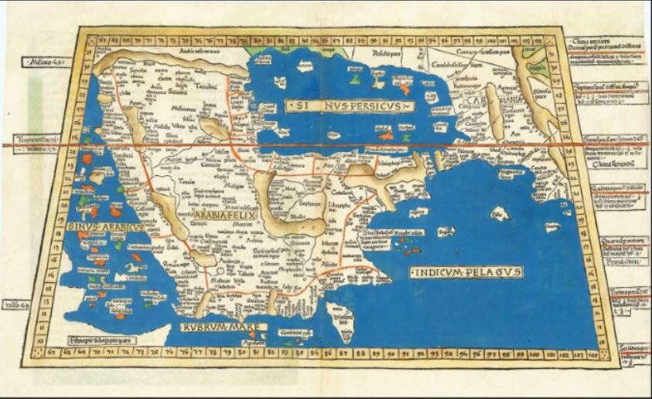
Ptolemy’s 2nd century References, mapped
(Created by Lienhart Holle - 1482)
Mecca doesn’t exist
2nd Century Map of Arabia
?
Where’s
Mecca?

Slide 20
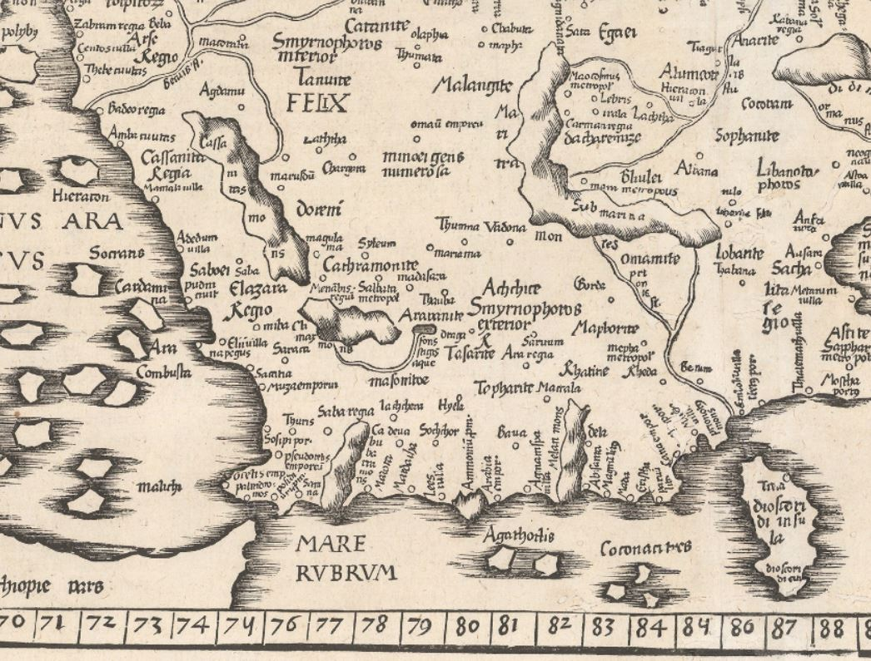
Ptolemy’s 2nd century References, mapped
(Created by Laurent Fries – 1541 AD)
Mecca doesn’t exist at all!!
2nd century Map of Arabia
?
Where’s
Mecca?

Slide 21
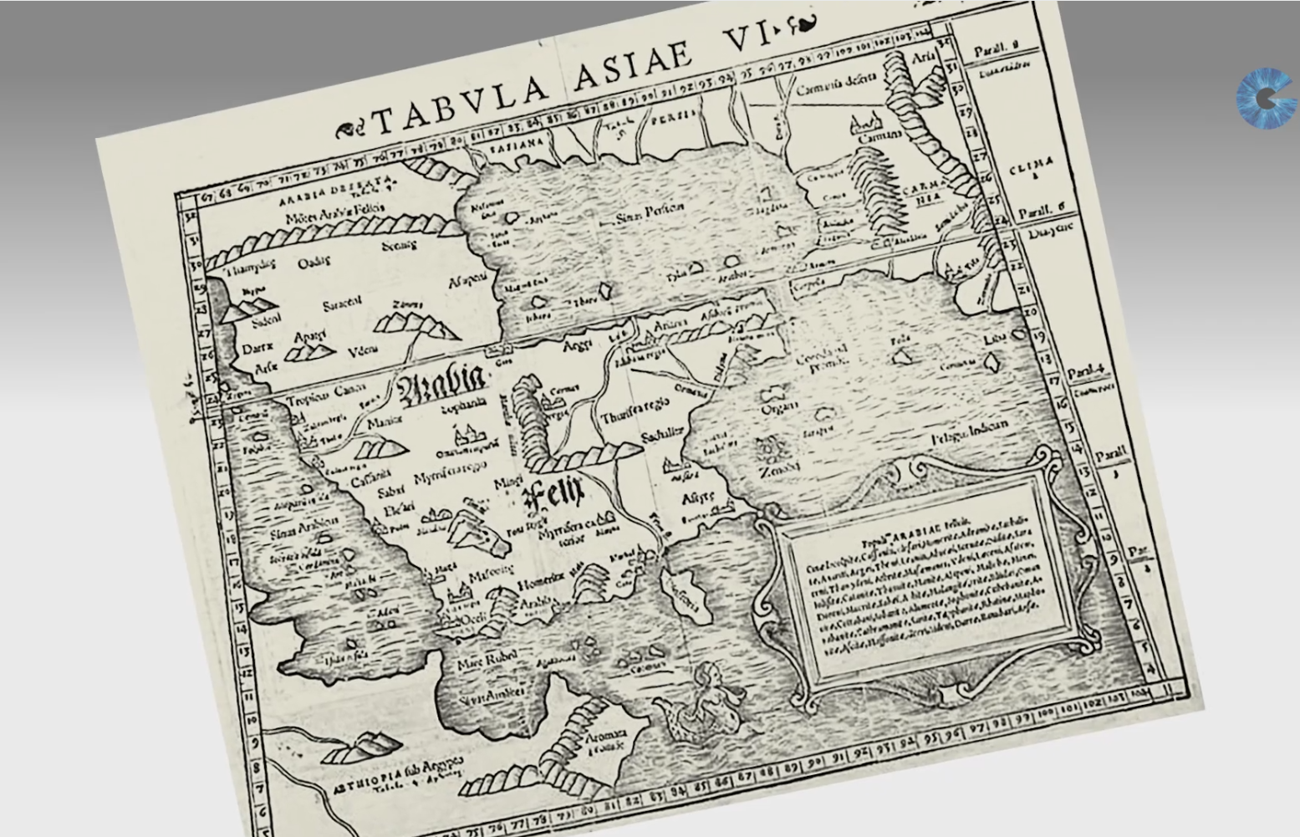
Ptolemy’s 2nd century References, mapped
(Created by Sebastian Munster - 1571)
Mecca still doesn’t exist
2nd Century Map of Arabia
?
Where’s
Mecca?

Slide 22
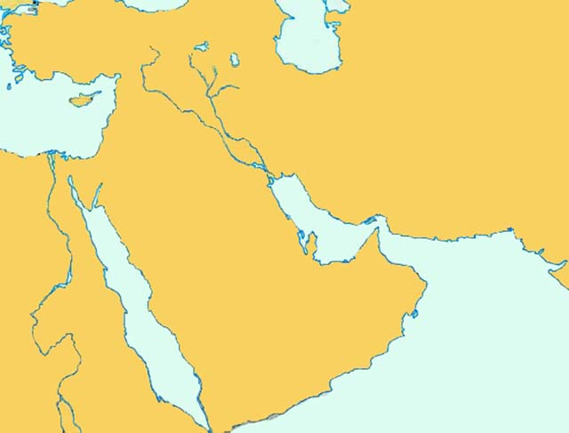
Why all Qiblas facing Petra, and not Mecca up to 706 AD?
Even the Qiblas (the direction of prayers) are not towards Mecca, but towards Petra!
Medina – 626 AD
Guangzhou, China – 627 AD
Cherman, India - 629 AD
Jami’ Hama al’Kabir, Syria – 637 AD
Fustat, Egypt – 642
Dome of the Rock, Israel – 690 AD
Humeina, Jordan – 699 AD
Amman, Jordan – 701 AD
Grand Sa’ana, Yemen – 705 AD
Khirbat al Minya, Israel – 706 AD
Asia Minor
Hama, Syria
Jerusalem
Israel
Humeina (Amman), Jordan
Petra
Fustat
Guangzhou, China?
Egypt
Medina
Mecca
Arabia
Cherman, India
Note: Every Qibla from 624 – 706 AD is facing Petra, and NONE are facing Mecca
Sa’ana

Slide 23
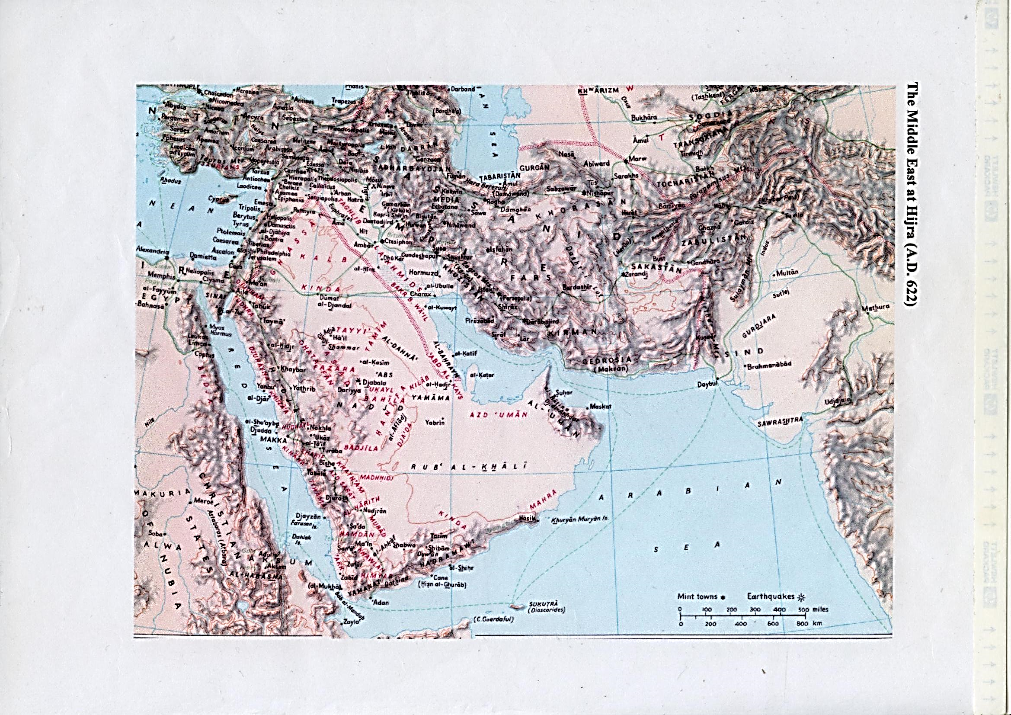
’Trade Route Theory’ (Montgomery Watt)
(Debunked)
BYZANTINE
HOLD ON!!
We’ve just learned something new concerning the Red Sea Trade Route!
SASANIAN
Gaza
Petra
X
Adulis

Slide 24
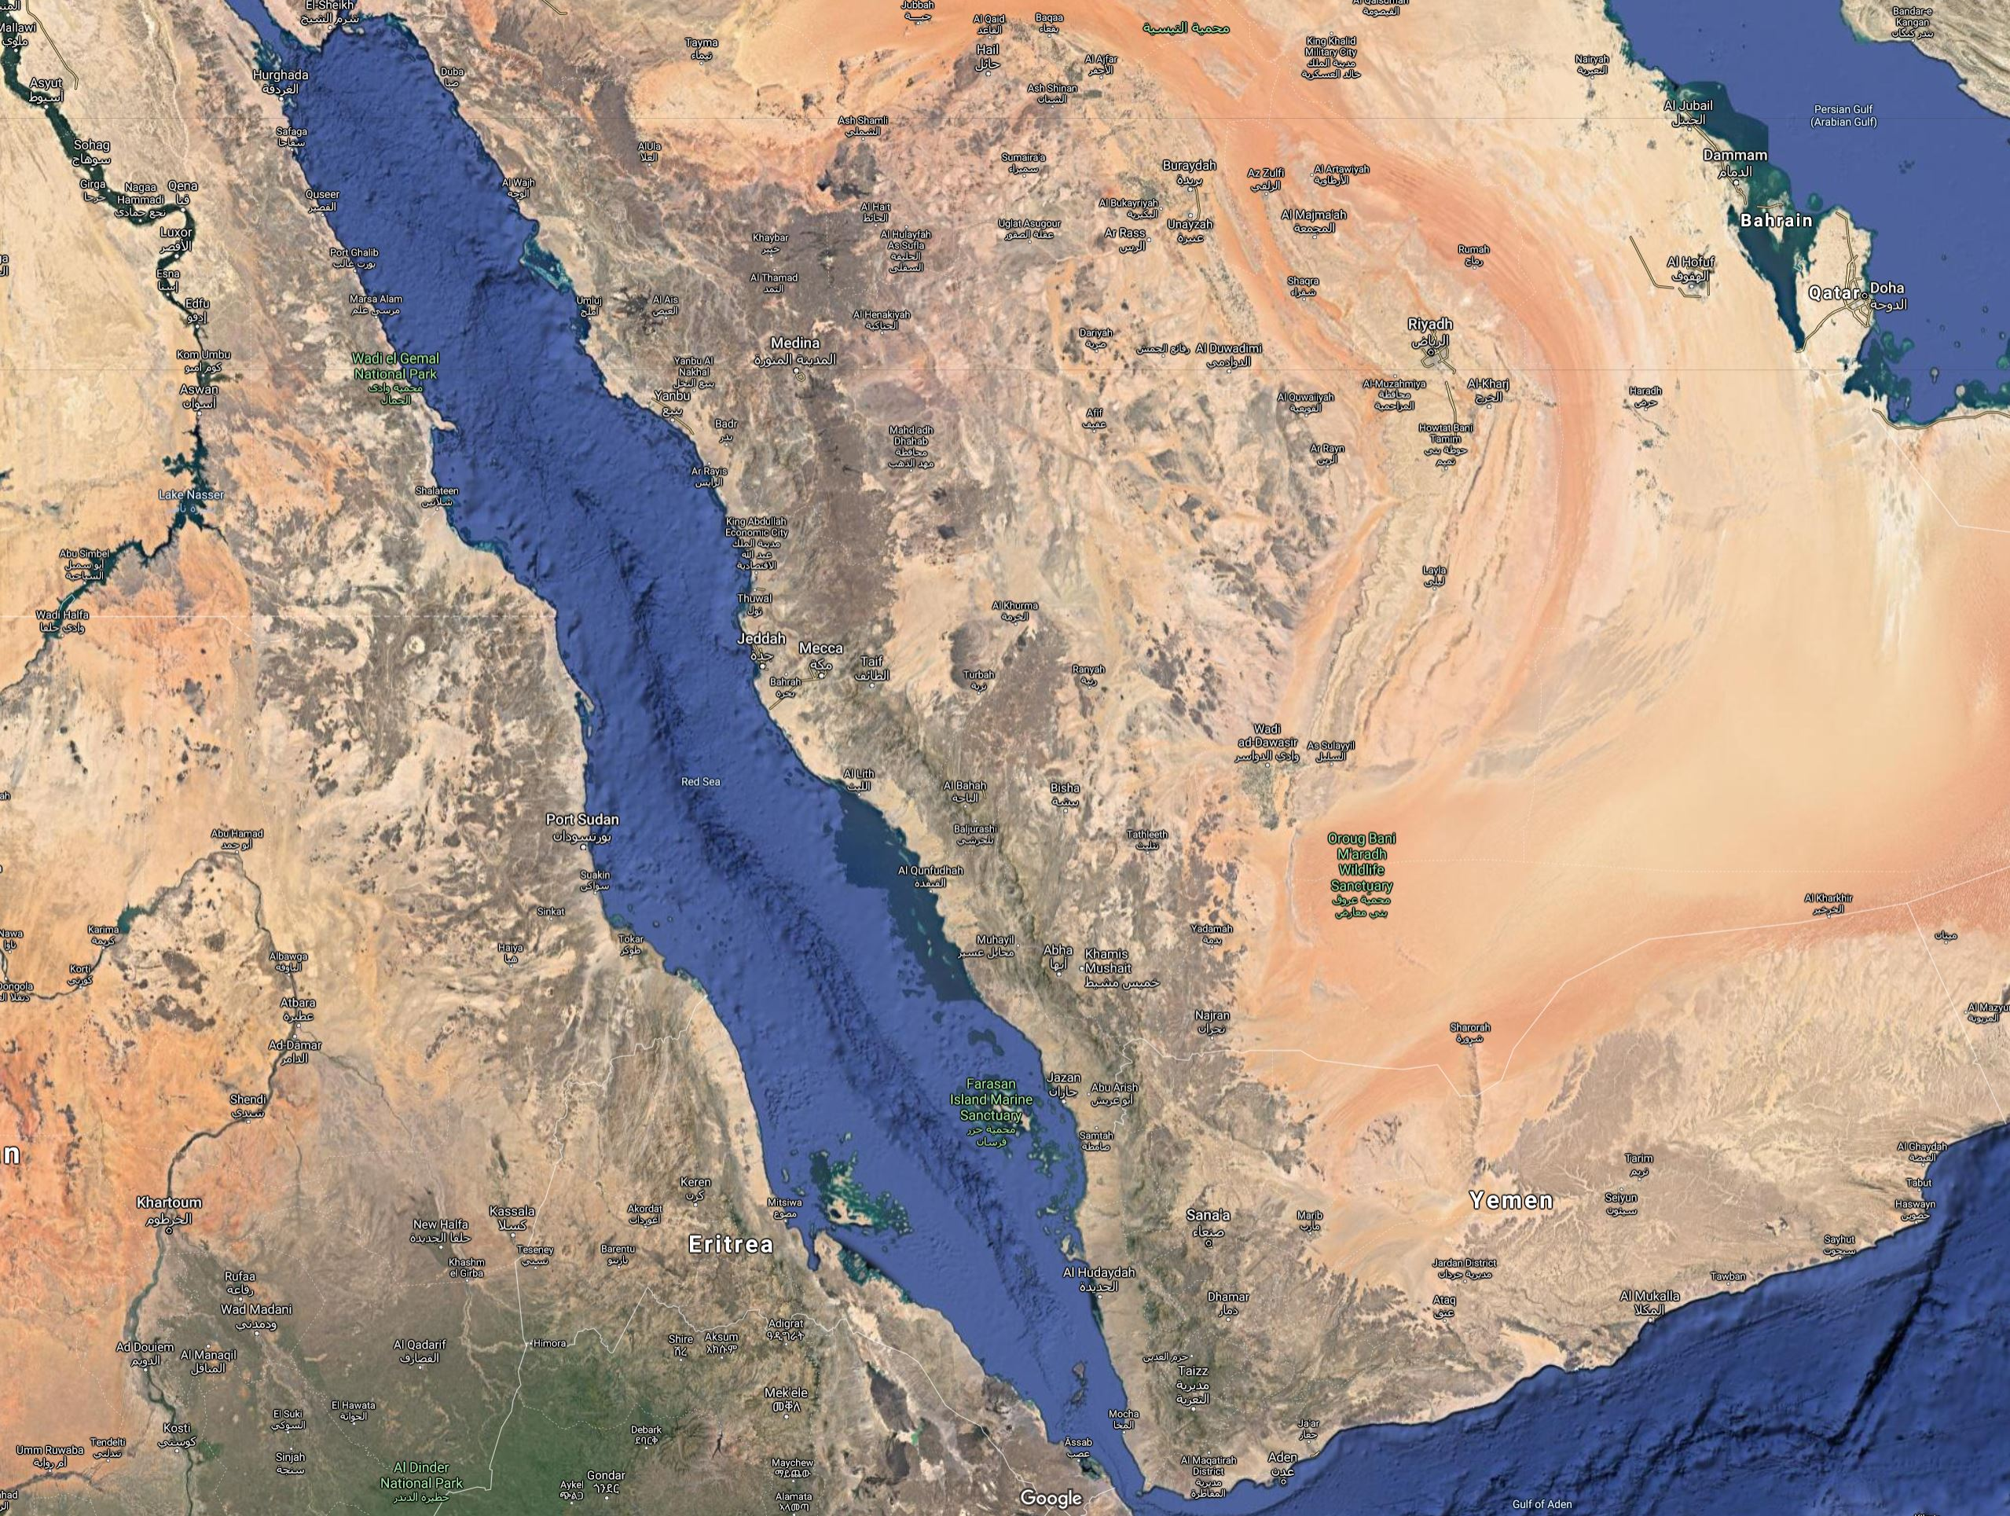
The RED SEA via Mecca debunked!
To understand the problem, we must use a Topographical map, to see the Water ways in the Red Sea (Chiara Zazzaro - 2013)
In the center of the Red Sea is a deep-water channel (Red arrows), which accommodates large modern ships today
To the West of this central channel are two shallower water channels (Golden arrows), where smaller ships can go, and stay close to the Western shore, for provisions
Unlike the Eastern Arabian shore which was arid, with no fresh water, and thus few people, the Western African shore had plenty of fresh water, and had larger populations
What’s more, the West coast had easily accessible ports!
We know their names…
Yanbu
Yathrib
Jeddah
Mecca
Aden

Slide 25
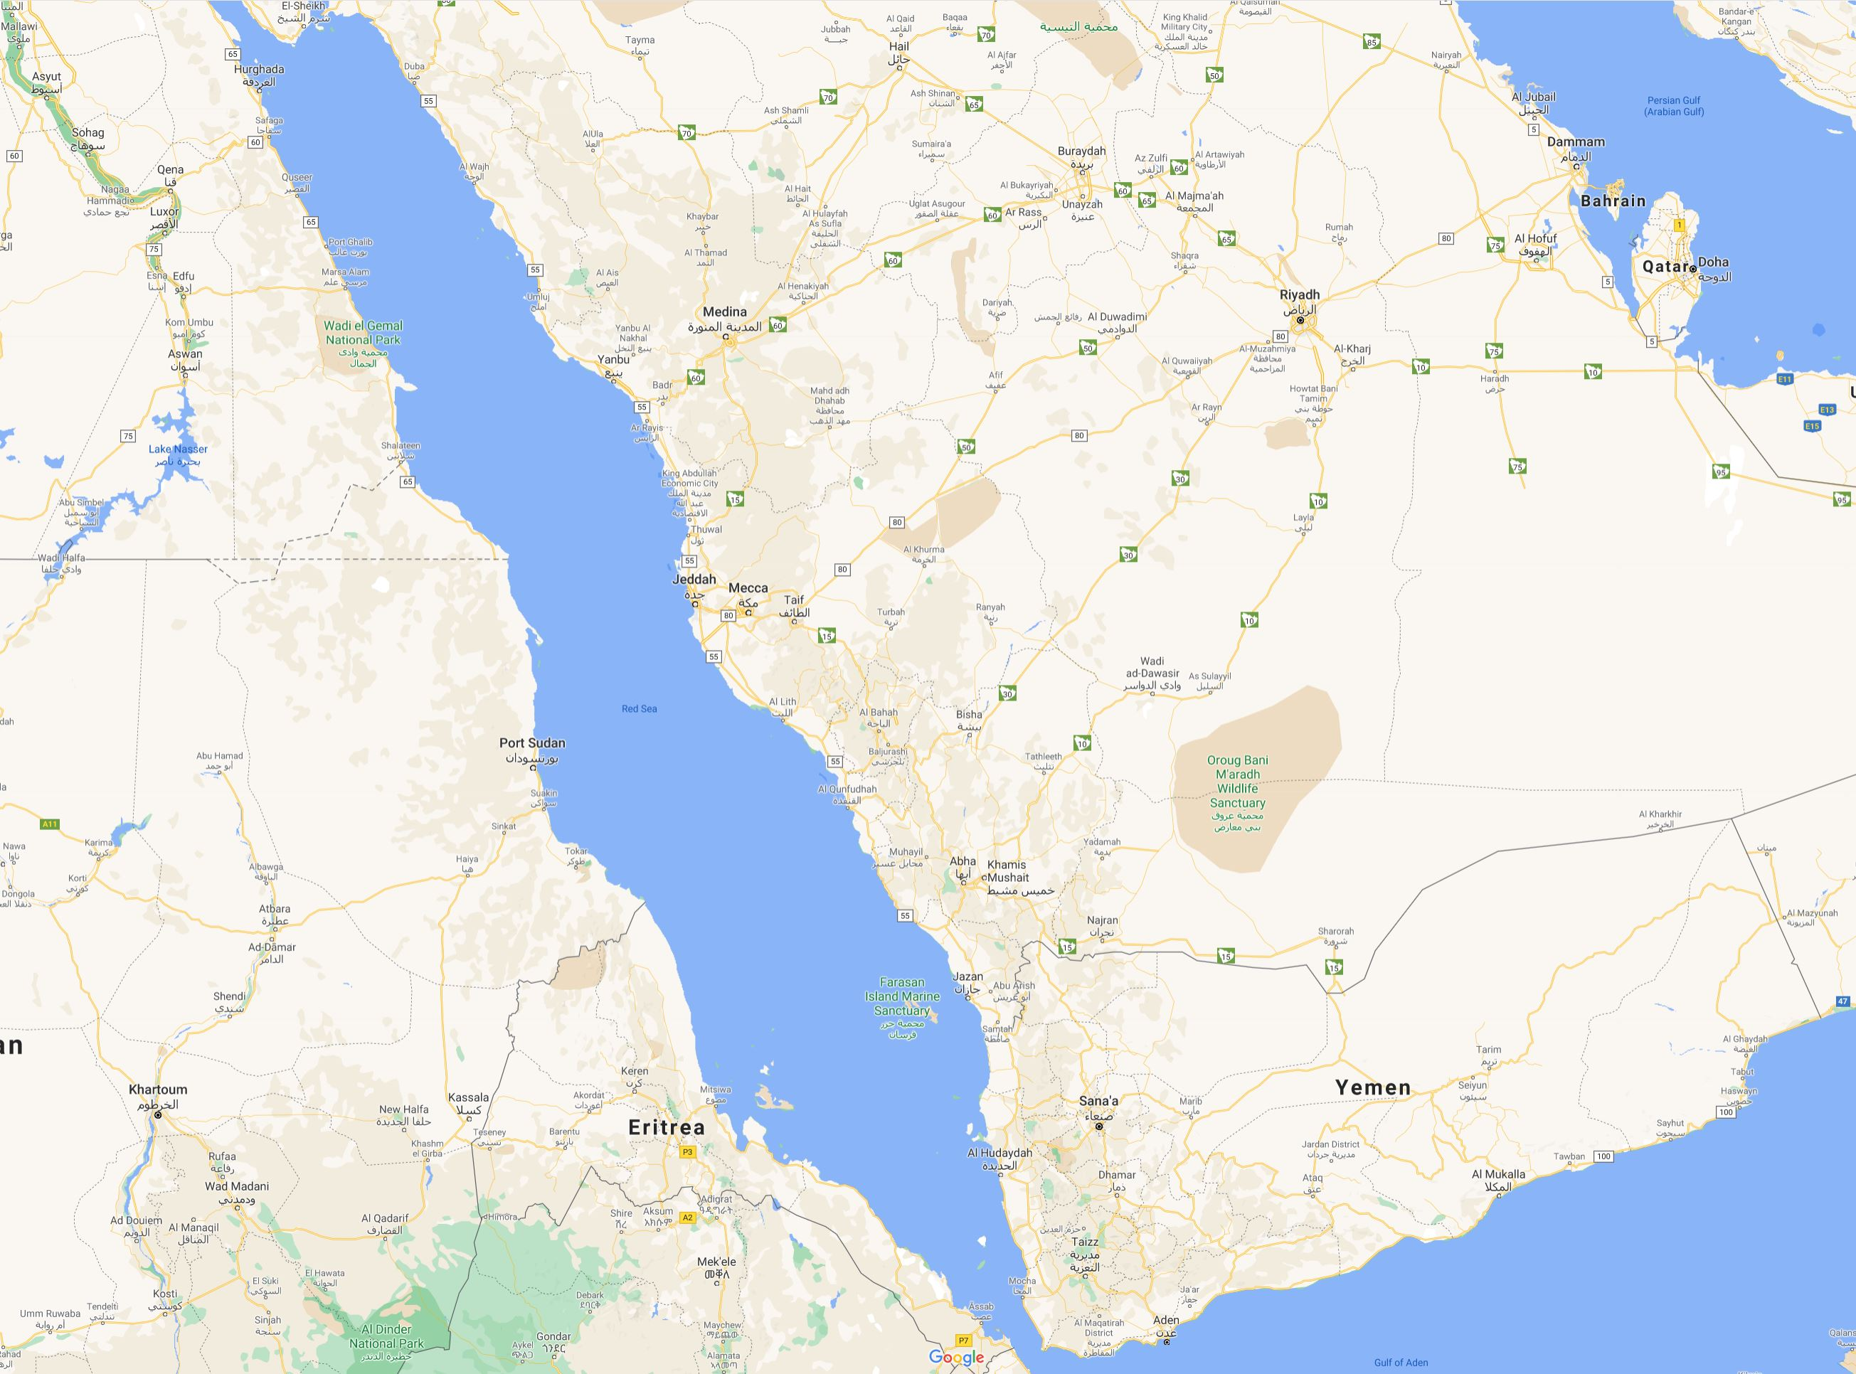
Ports along the WESTERN COAST of the RED SEA = AFRICA!
The 5 coastal cities along the Red Sea’s Western coast:
  Assab Eritrea (246 BC)
  Adulis, Eritrea (79 AD)
  Suaken, Sudan (170 AD)
  Berenice, Egypt (275 BC)
  Safaga, Egypt (282 BC)
Their dates all predate Islam
All 5 are a day’s distance
On the Red Sea’s Eastern Arabian coast, only Yanbu is known, as Yathrib’s port city
What about Jeddah, as a port for Mecca?
We have no history for either Jeddah or Mecca until the 8th century AD
Why? Because neither had water, nor a population large enough to accommodate early trade
Without Mecca, what then happens to 7th c. Islam?
Safaga
(282 BC)
Yanbu
Yathrib
Berenice
(275 BC)
Jeddah
Mecca
Suakin (170 AD)
Adulis (79 AD)
Assab (246 BC)

Slide 26
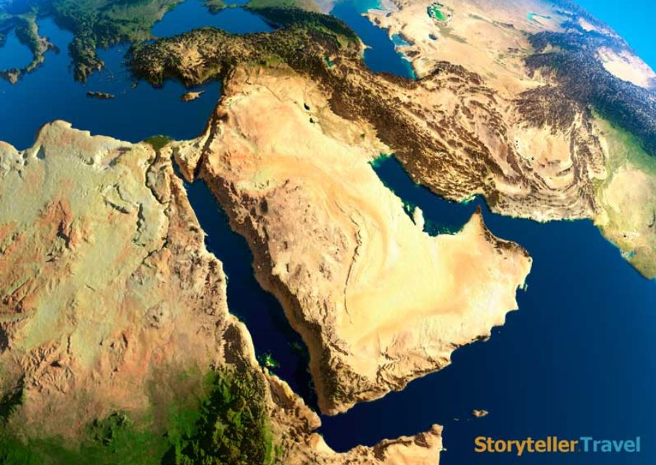
Let’s remind ourselves of where exactly Mecca is, in relation to the other known cities in Arabia…
Gaza
Petra
Tabuk
Yathrib/Medina
Taif
MECCA
Najran
Sana
Aden

Slide 27
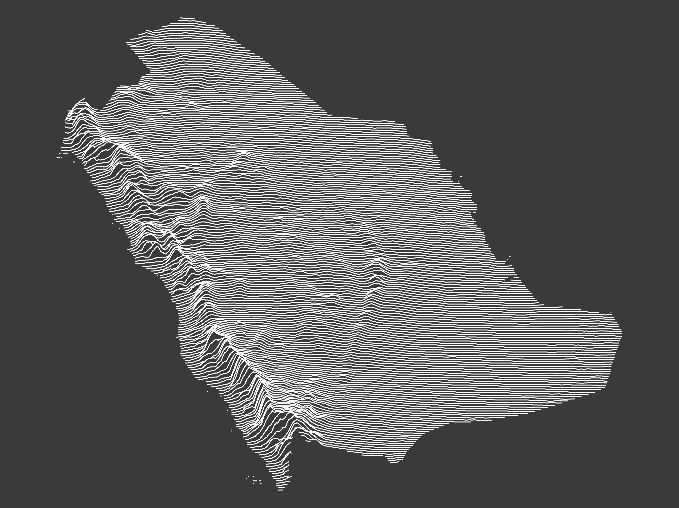
Gaza
Petra
Let’s look at a Topographical map of Arabia, on a graph
Tabuk
What do ancient Maps show us concerning Mecca?
Yathrib/Medina
MECCA
Taif
Najran
Sana
Aden

Slide 28
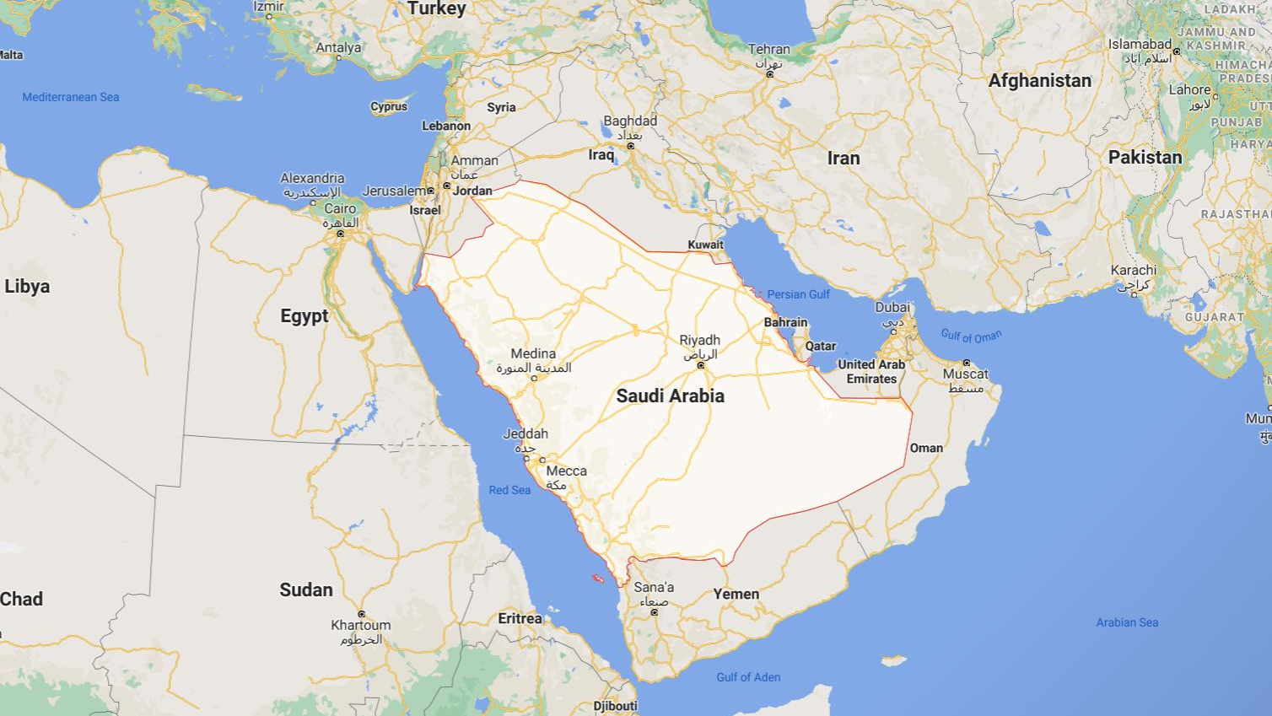
Roman Empire
Was Mecca known?
Assyrians
Patriarchs
Central
Western
Arabia
Babylonians
Persian Empire
Tayma
If Mecca was the oldest city in the history of mankind, then someone, somewhere in the areas surrounding it should have heard of it…right?
Eastern
Arabia
What about those empires which were in that area?
Mecca
Western Arabia
Not one of them had heard of Mecca!
Saba
Himyarites
Himyar

Slide 29
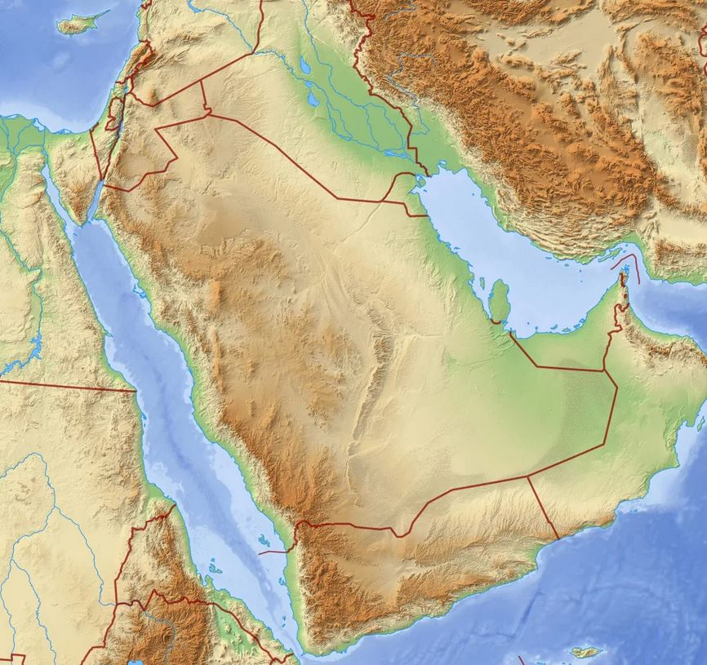
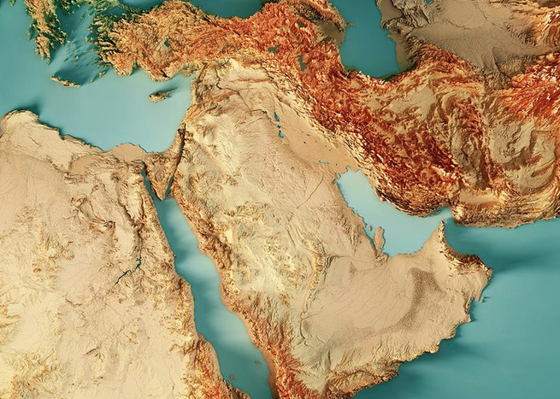
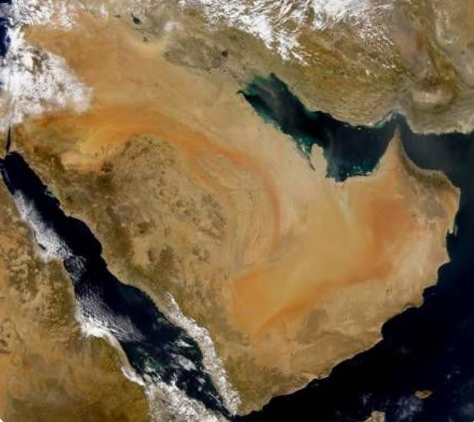
History needs Civilizations, which need water…
What can you observe about these 4 Topographical Maps of Saudi Arabia?
The Central part, with Medina and Mecca, is all a DESERT!
Where there is a desert, there’s no water
Where there is no water, there’s no food
Where there is no food, there’s no people
Where there are no people, there’s no towns
Where there are no towns, there’s no cities
Where there are no cities, there’s no civilization
Where there is no civilization, there’s no history!
Just, like Mars, without water, there is no point in ever going there…
So, what about the Hajj in Mecca?
Medina
Medina
Mecca
Mecca
Medina
Medina
Mecca
Mecca

Slide 30
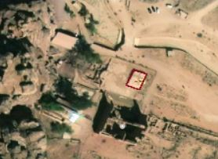
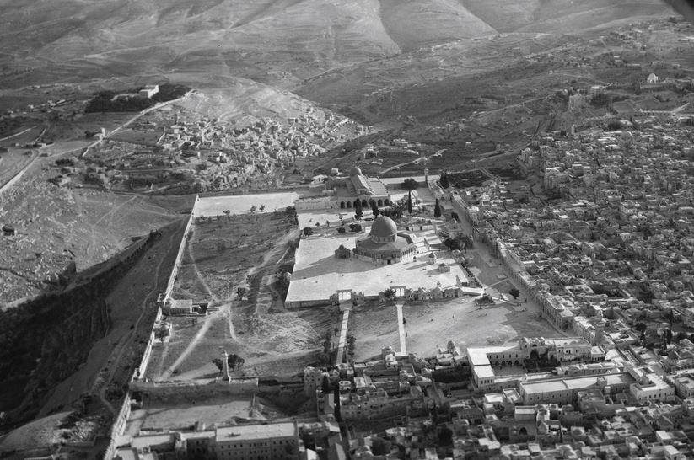
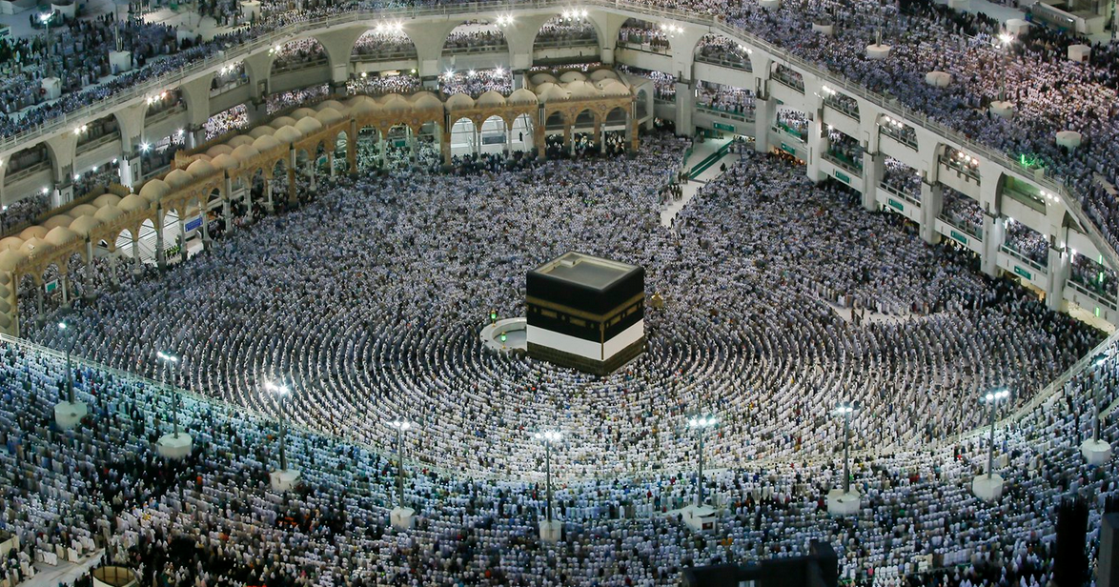
The Stages of the Hajj are mostly borrowed
Meccan Kaa’ba
Circumambulation Counter-clockwise 7 times
Why?
Jerusalem Kaa’ba
Circumambulation Counter-clockwise 7 times
So, the Ka’aba was originally used in Jerusalem, then moved to Petra, and finally to Mecca
Petra Kaa’ba
Also Circumambulation Counter-clockwise 7 times
Why?

Slide 31
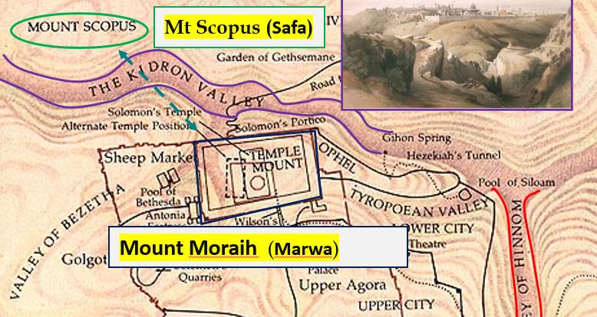
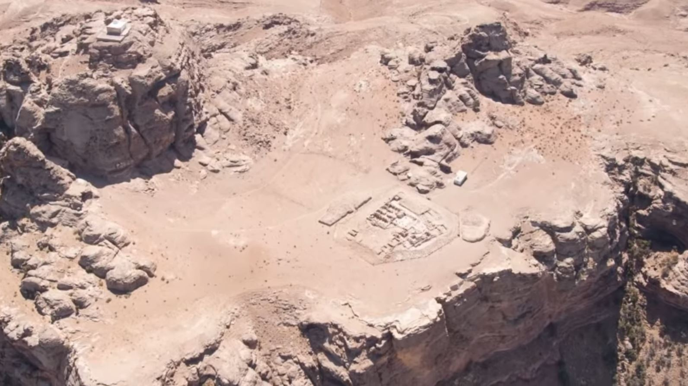
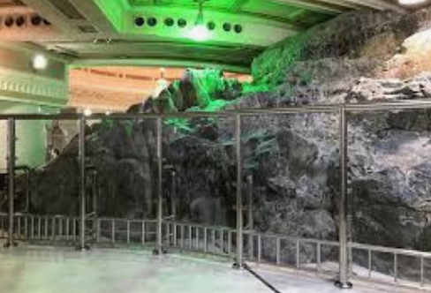
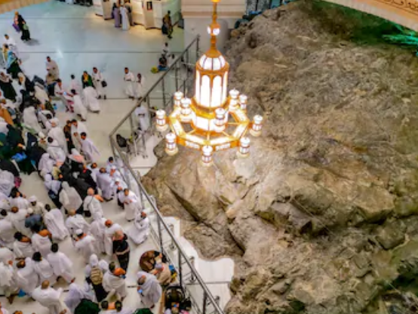
Mount Marwa and Mount Safa
Marwa & Safa (Mecca)
Why are they in Mecca?
Why are they only 20 feet high?
Why do they Run back-and-forth 7 times?
Why?
Marwa & Safa (Petra)
But where do they run?
Why here?
Marwa & Safa (Jerusalem)
Mt. Moriah (Marwa)
Mt. Scopus (Safa)
Kidron Valley in-between
These are the original Marwa and Safa mountains (and the original Ka’aba)

Slide 32
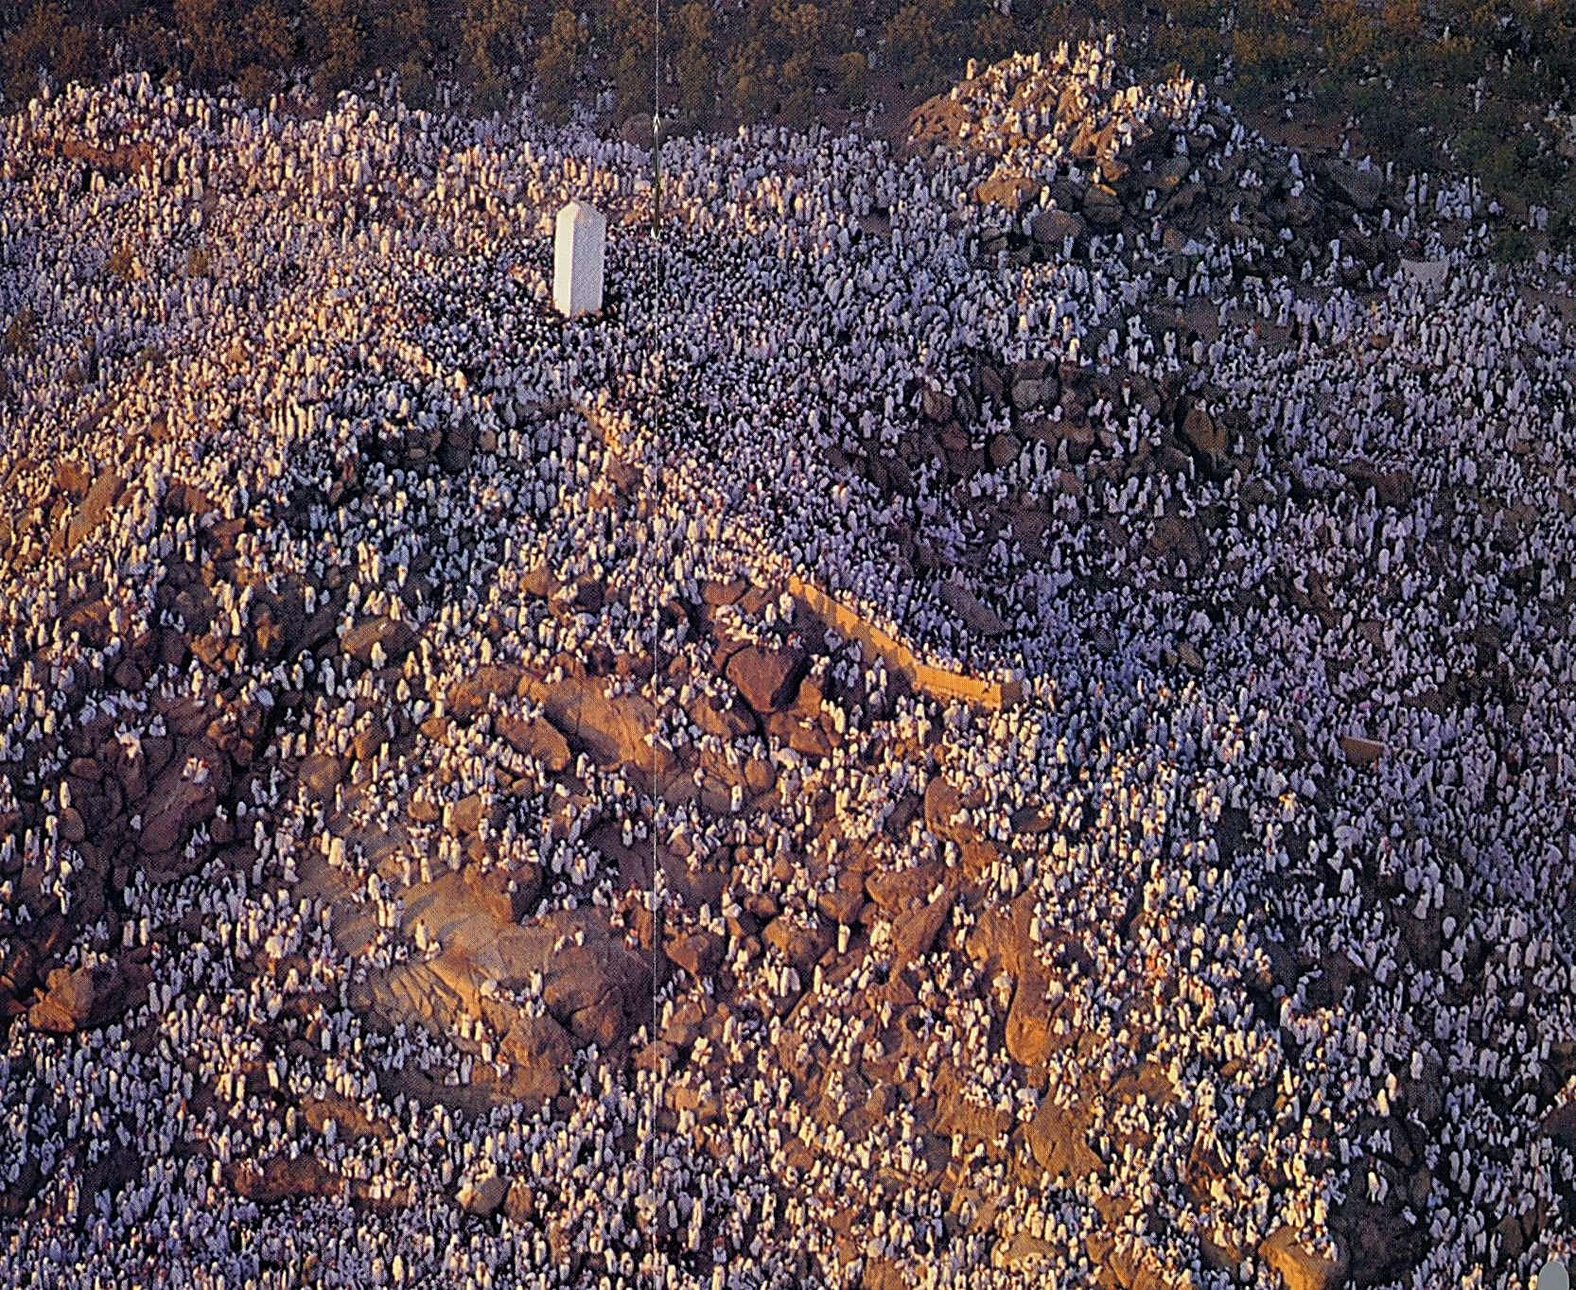
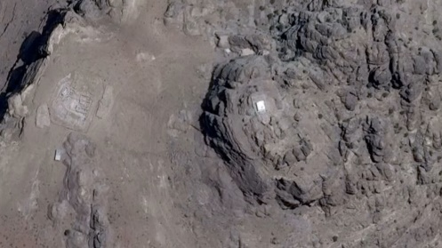
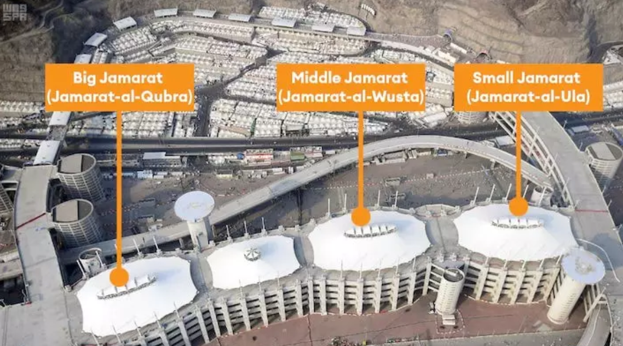
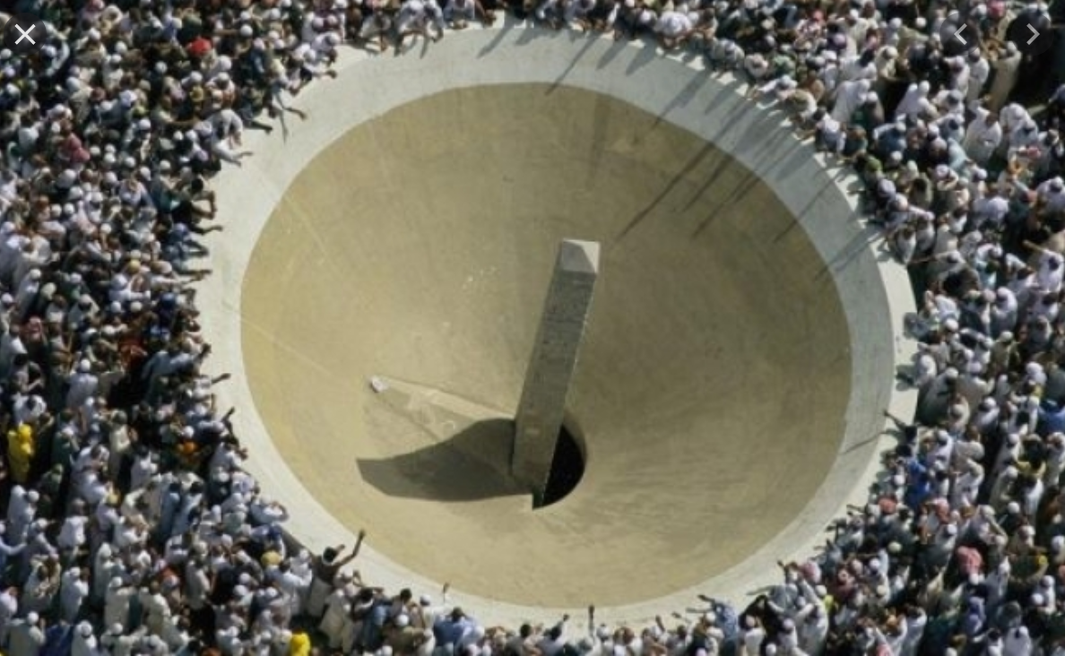
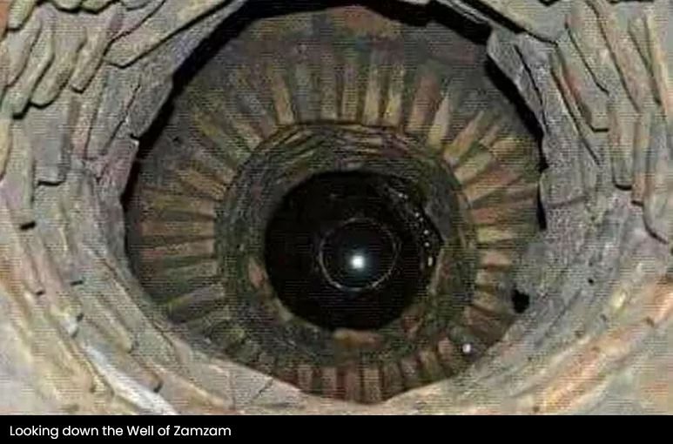
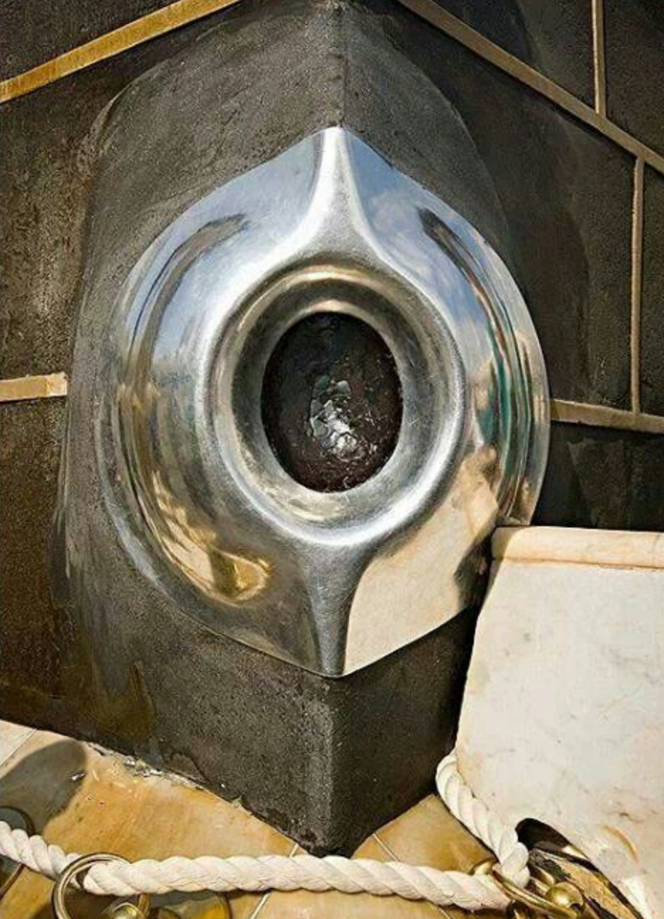
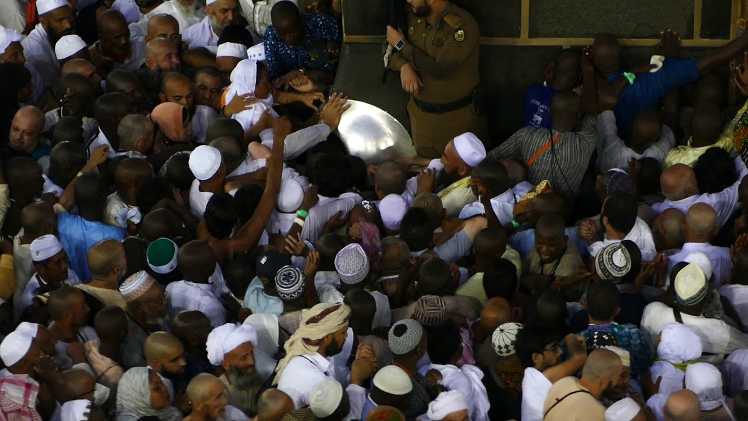
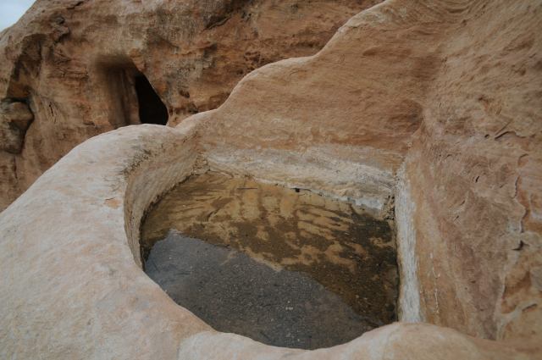
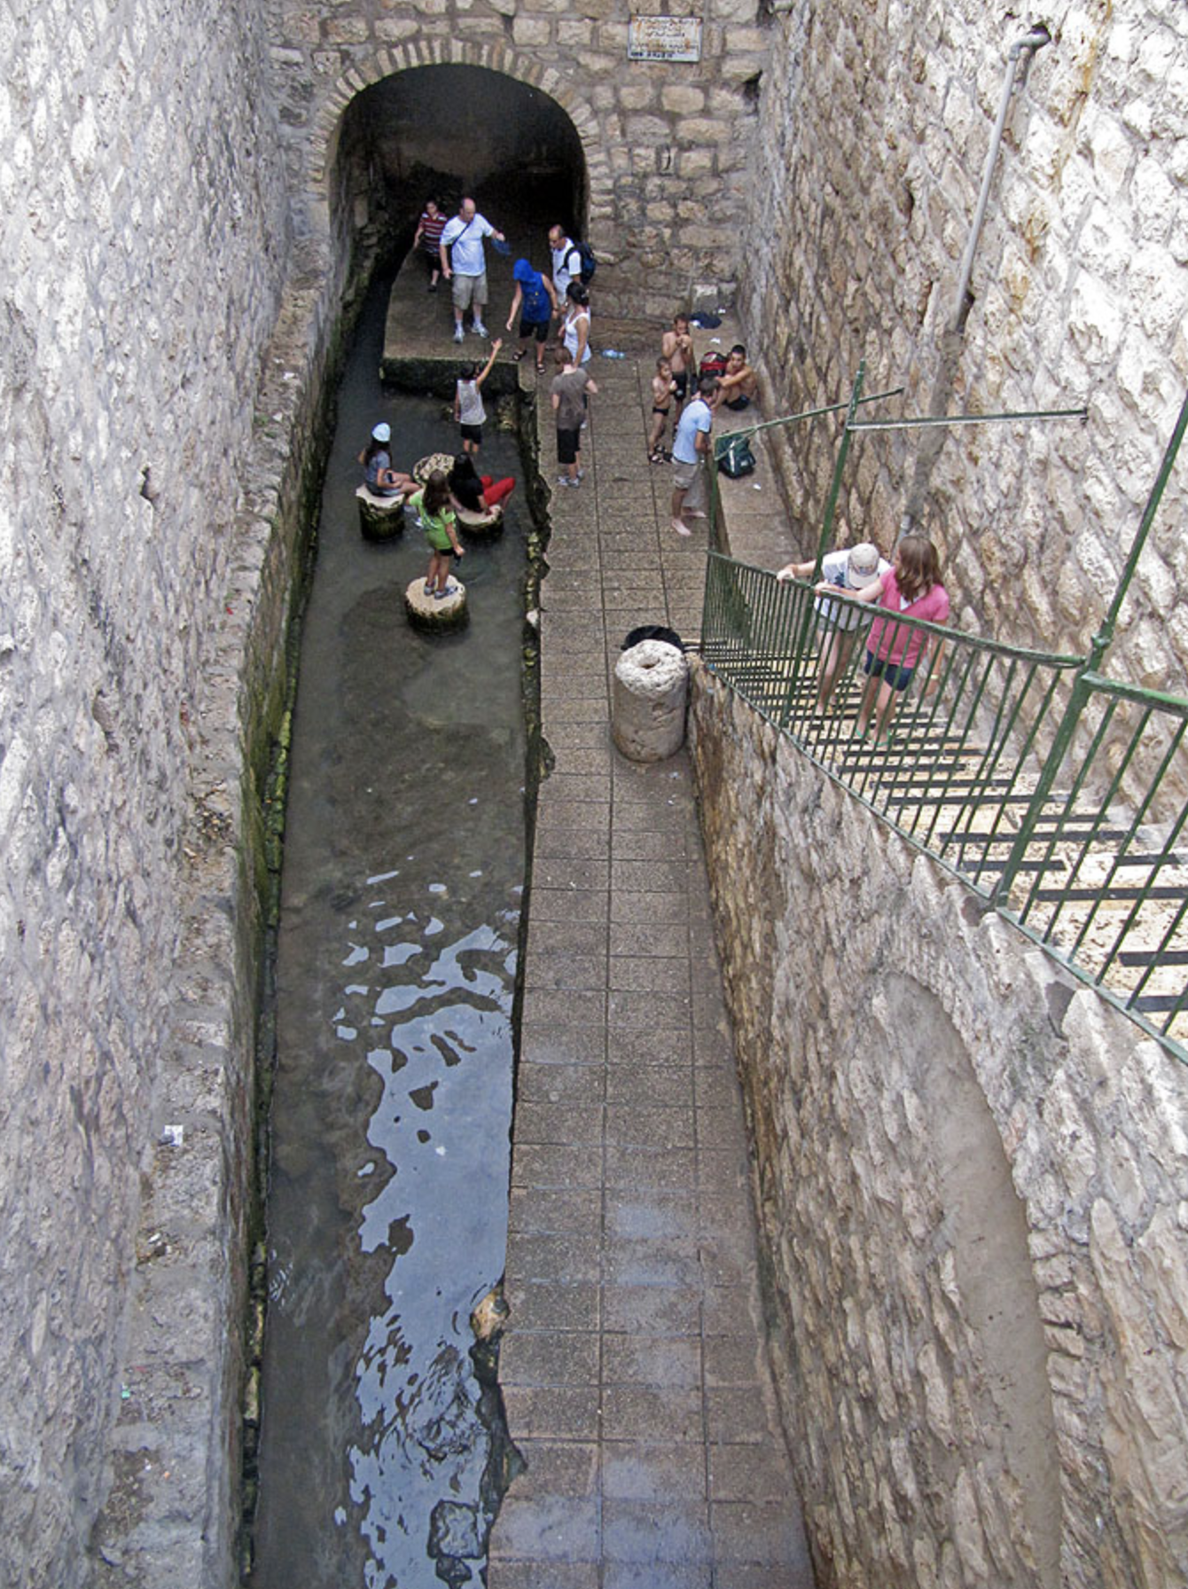

The 5 Stages of the Hajj are all borrowed
The Ka’aba in Mecca
Saafa and Marwa in Petra
The Hill of Arafat in Mecca
The Ka’aba in Petra
Saafa and Marwa in Mecca
The Hill of Arafat in Petra
The Ka’aba (cube) in Jerusalem
Saafa and Marwa in Jerusalem
Up to 1980 on 1 Jamarat in Mecca
The ZamZam well in Mecca
The 3 Jamarats in Mecca
The ZamZam well in Petra
The ‘Black Stone’? = Idolatry!
The 1 Jamarat in Petra
The Pool of Siloam
In Jerusalem

Slide 33
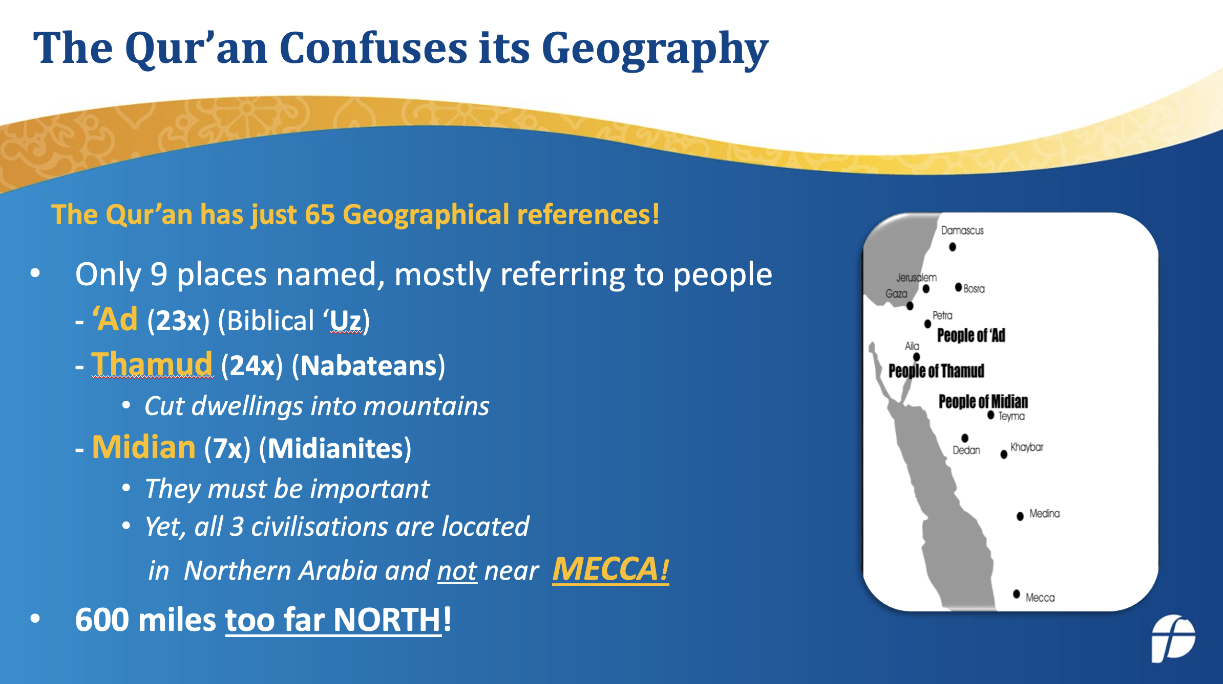
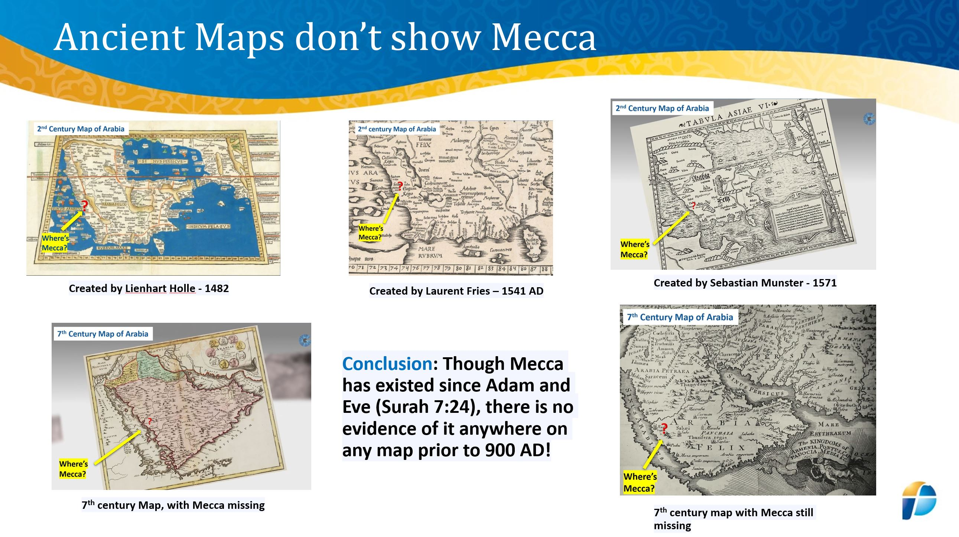
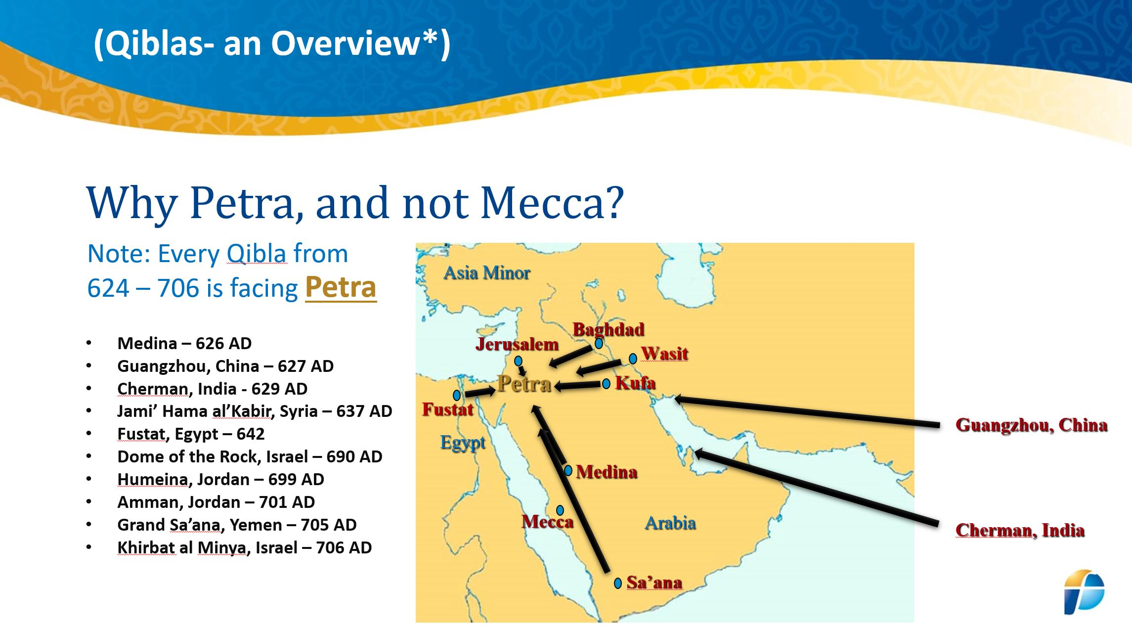
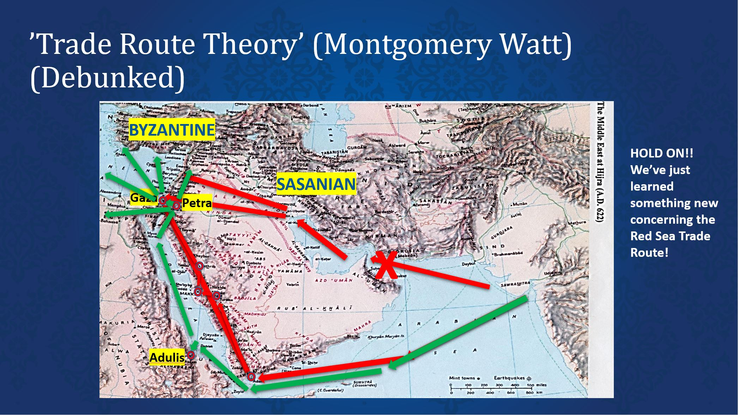
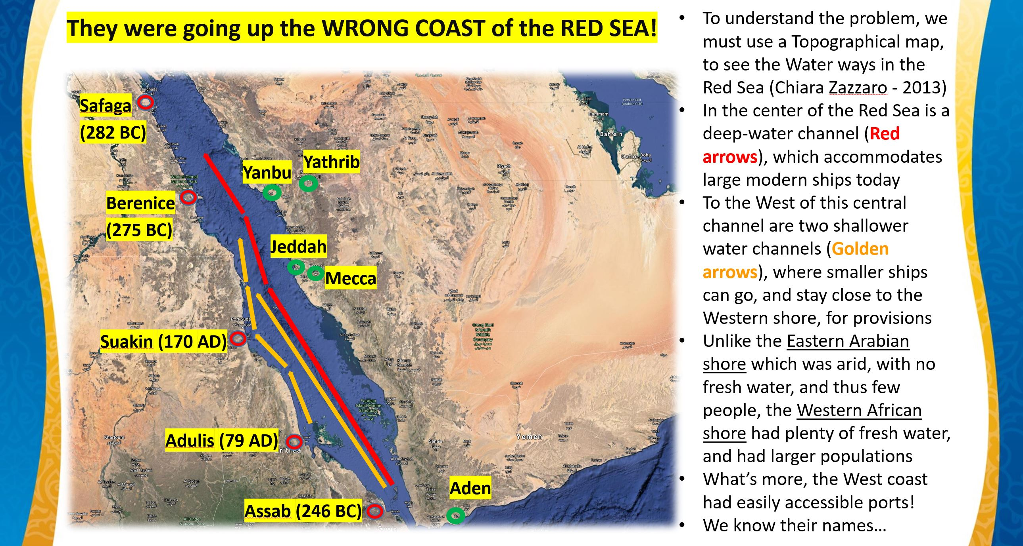
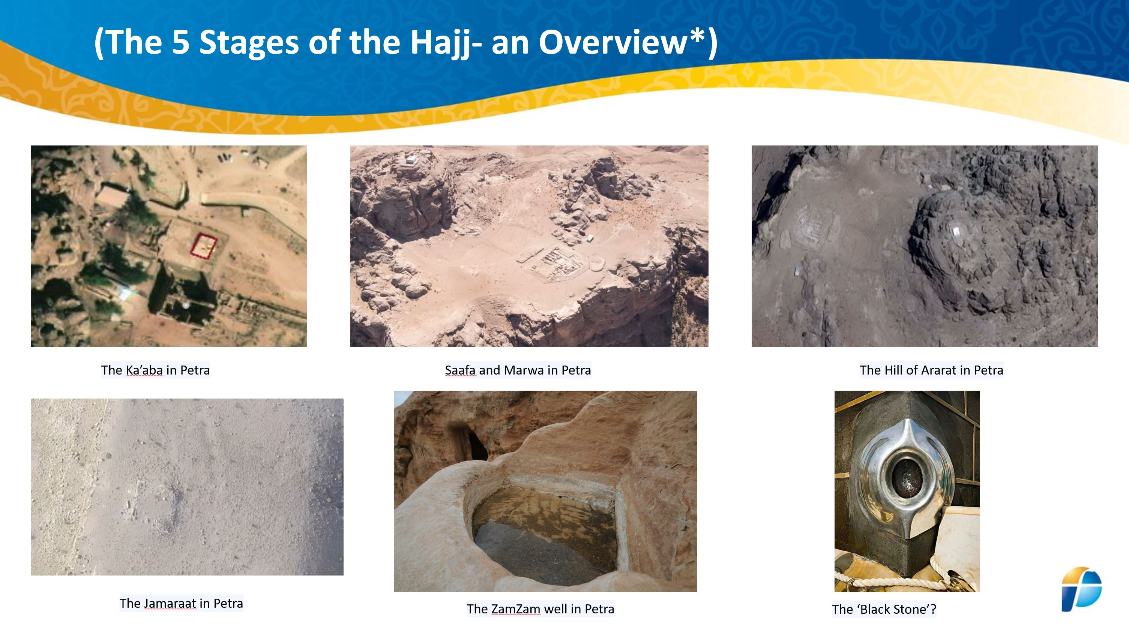
6 CONCLUSIONS CONCERNING MECCA’S HISTORICAL PROBLEMS
No-one could find Mecca placed in the Qur’an
Crone couldn’t find any Maps with Mecca until 900 AD
Gibson introduced all Qiblas facing Petra (2011-2017)
Crone Debunked the land-based trade via Mecca (1983)
We Debunked the sea-based trade via Mecca (2021)
Gibson debunked the 5 stages of the Hajj in Mecca
Conclusion: Though Mecca has existed since Adam and Eve (Surah 7:24), there is no evidence of it anywhere until 741 AD, and everything we now find in Mecca, we could previously find in Petra…and now, even earlier in Jerusalem!

Slide 34
3) THE PROBLEM WITH EARLY ISLAM
Just follow the evidence on the ground

Slide 35
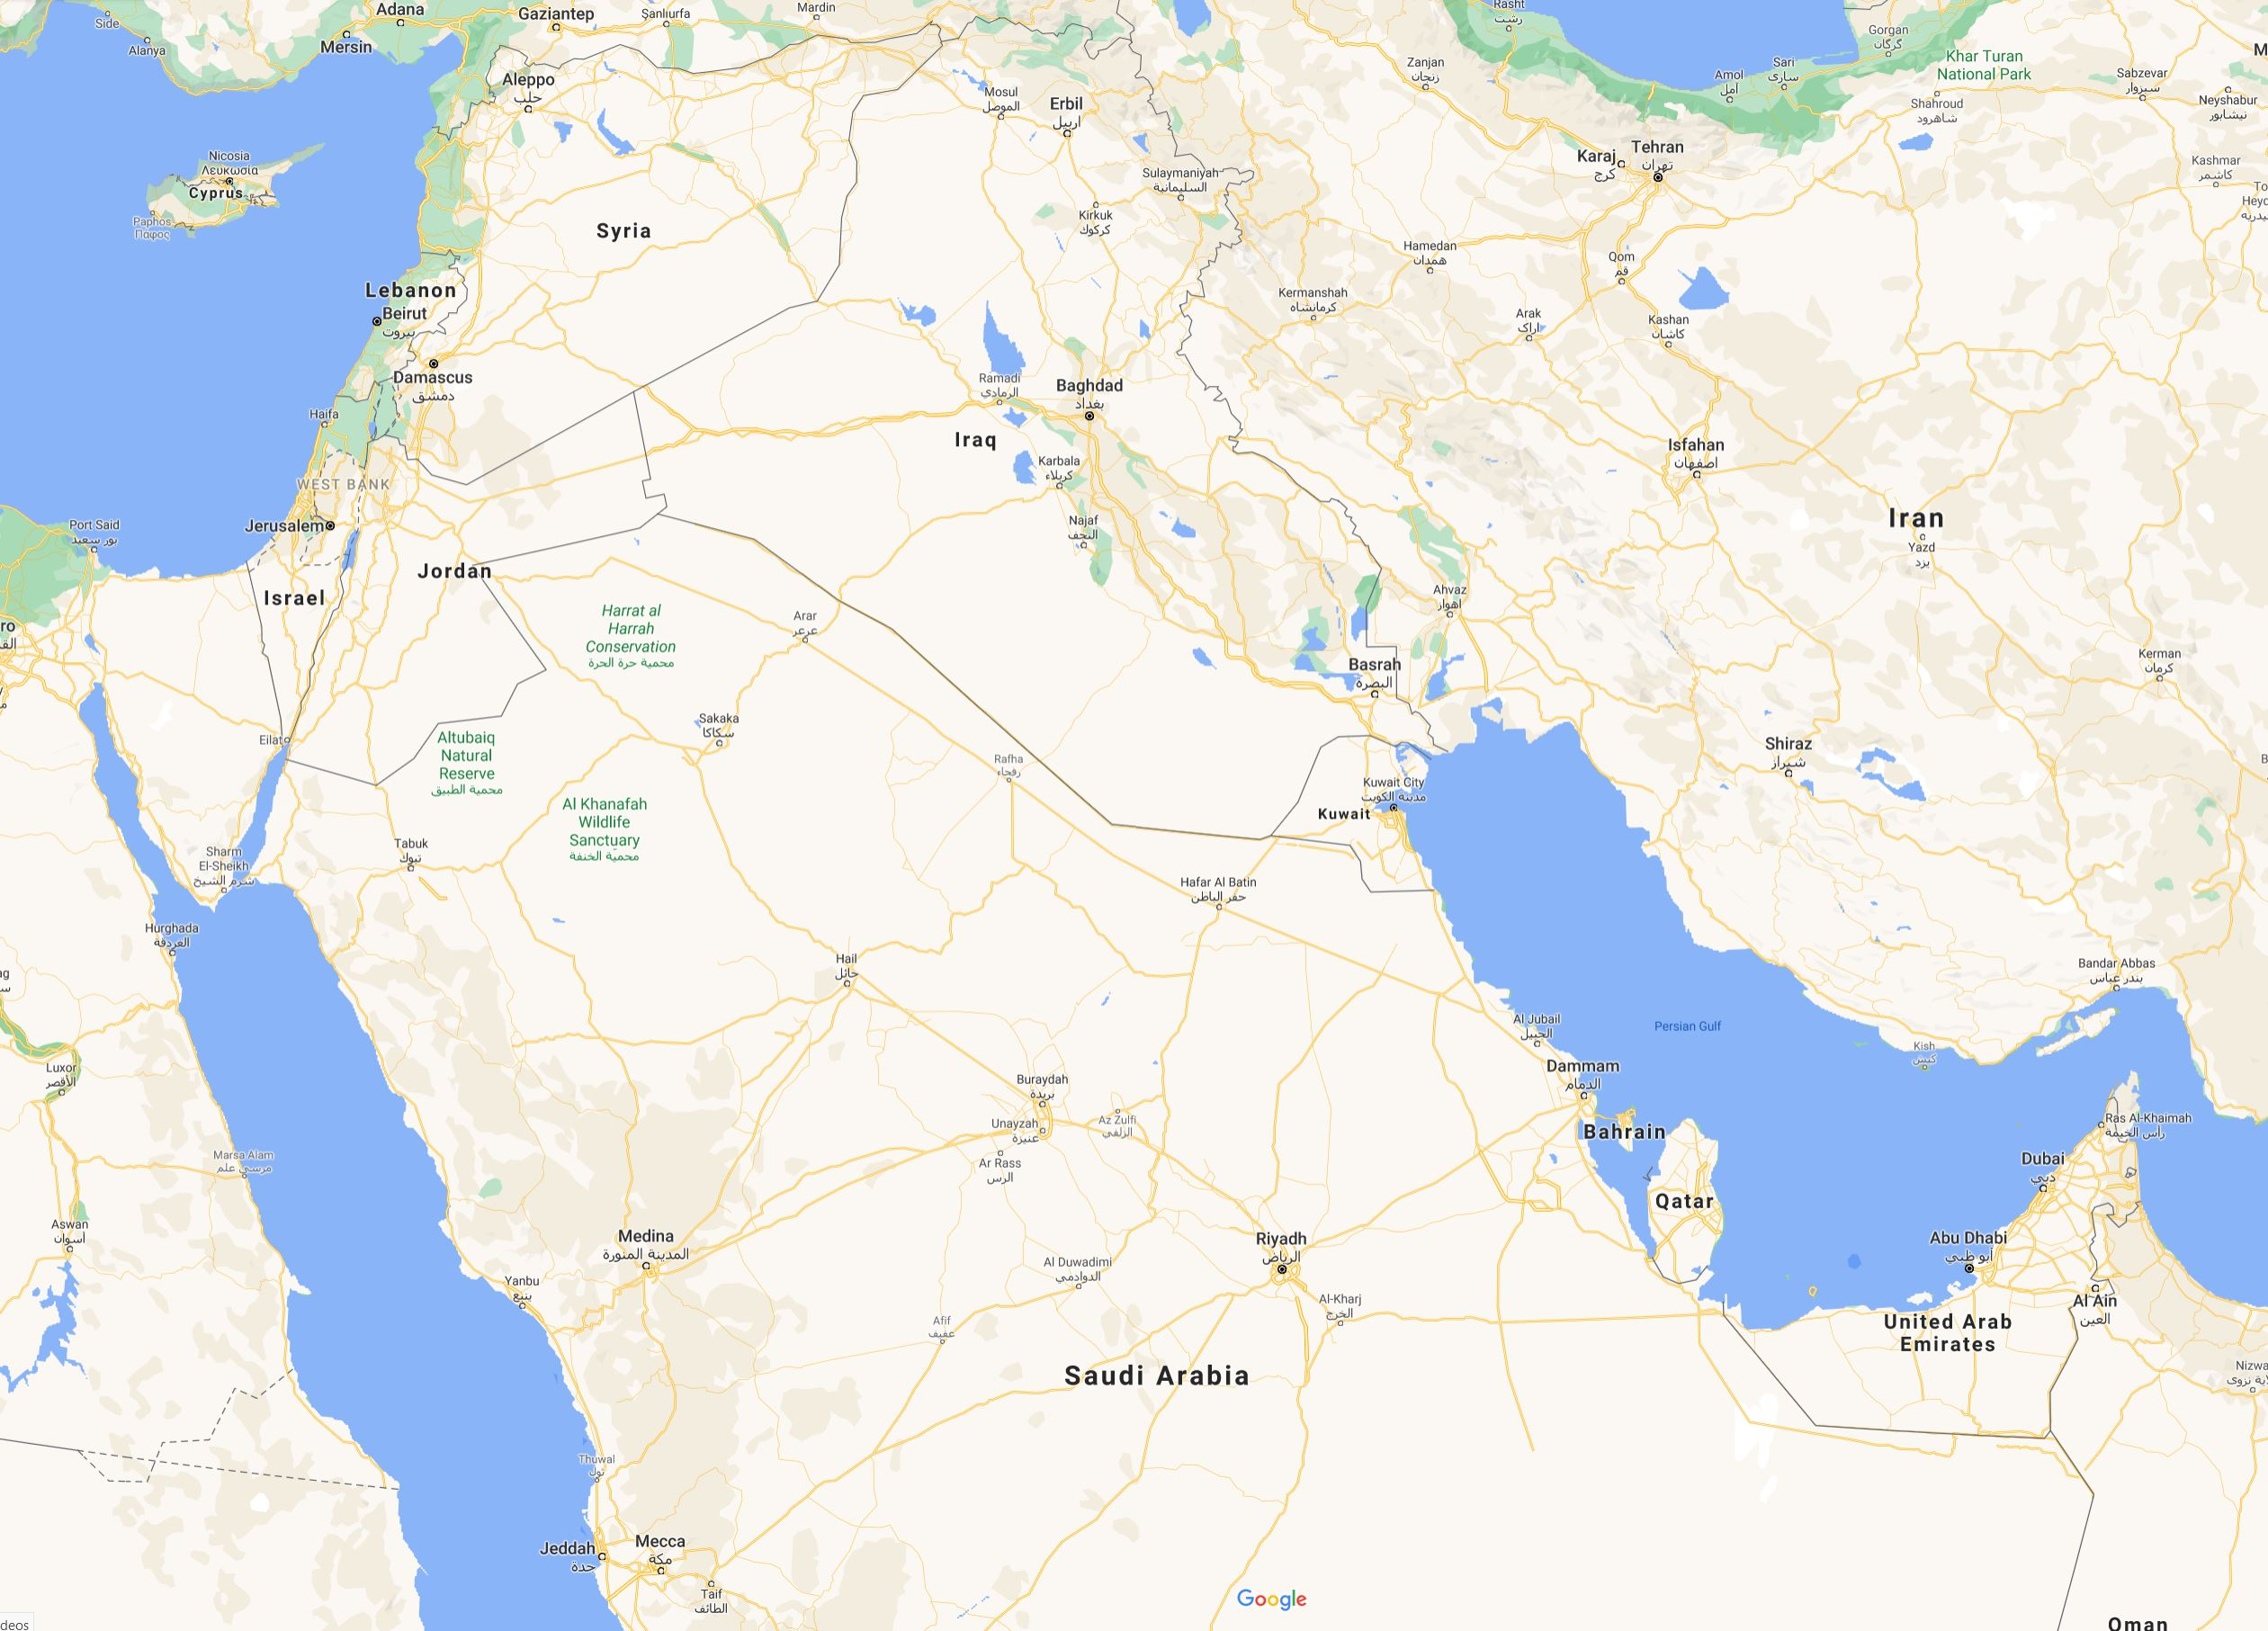
Starting with coins, note where the 7th c. Mints are situated in relation to
Mecca & Medina
The Western Mints
were all situated
in Modern day Syria,
Lebanon, & Israel
Tartus
Hims
Ba’albak
Tebariya
Dimashq
The Eastern Mints
were all situated in
Modern day Iran
Baysan
Abila
Susa
Yubna
Jerash
Amman
Illya
Dasht
Arrajan
Bishapur
Tanbuk
Istakhr
Kazerun
Note:
All of these mints
would have been
under the authority of any Arab leader, or Caliph in the 7th century, including any Muslim Caliph
Ardashir Khurra
Darabjird
Conclusion:
None of these mints
were in the Hejaz.
Instead, they were
all situated too far
North
Kavad Khurra
Medina
Mecca

Slide 36
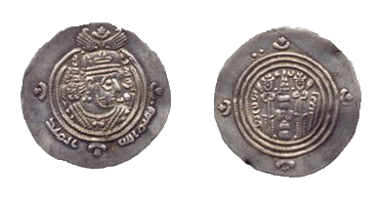
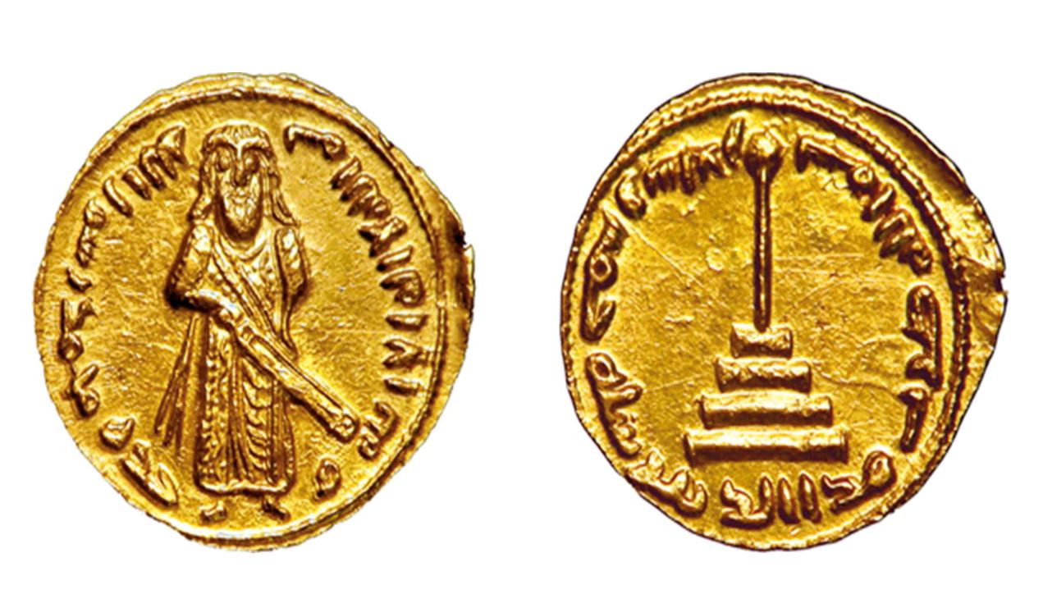
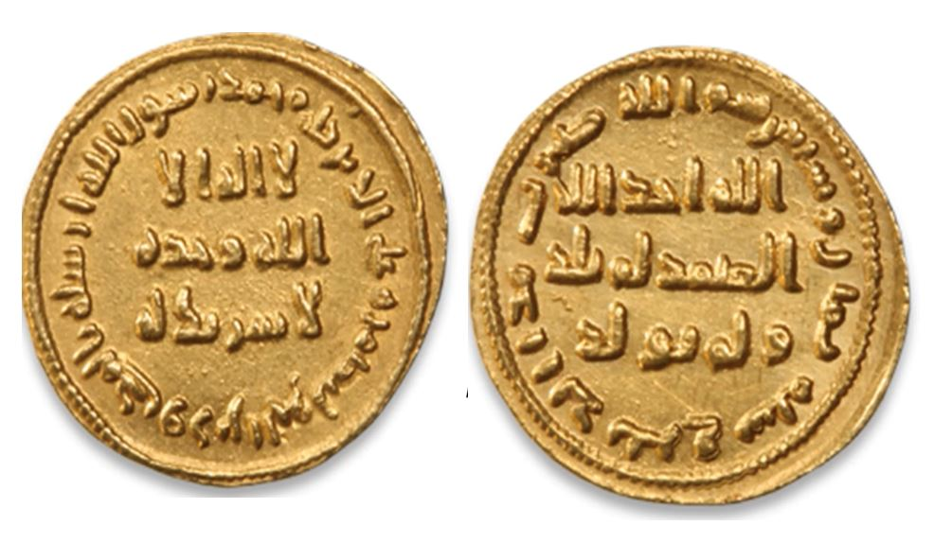
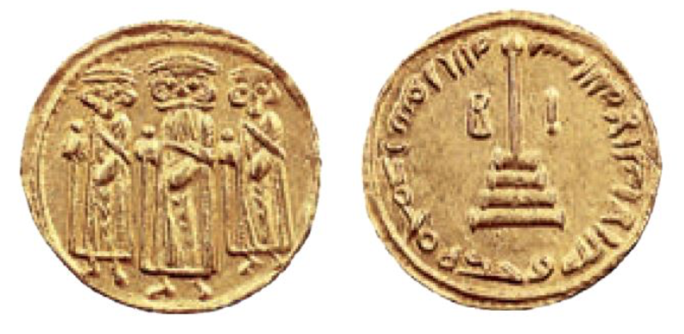
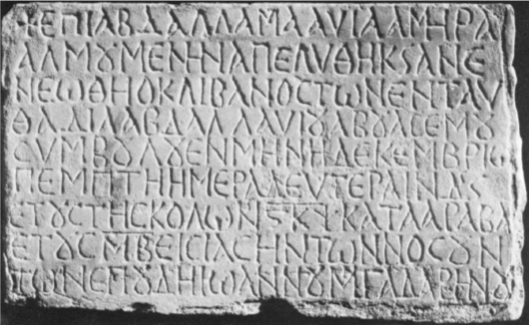
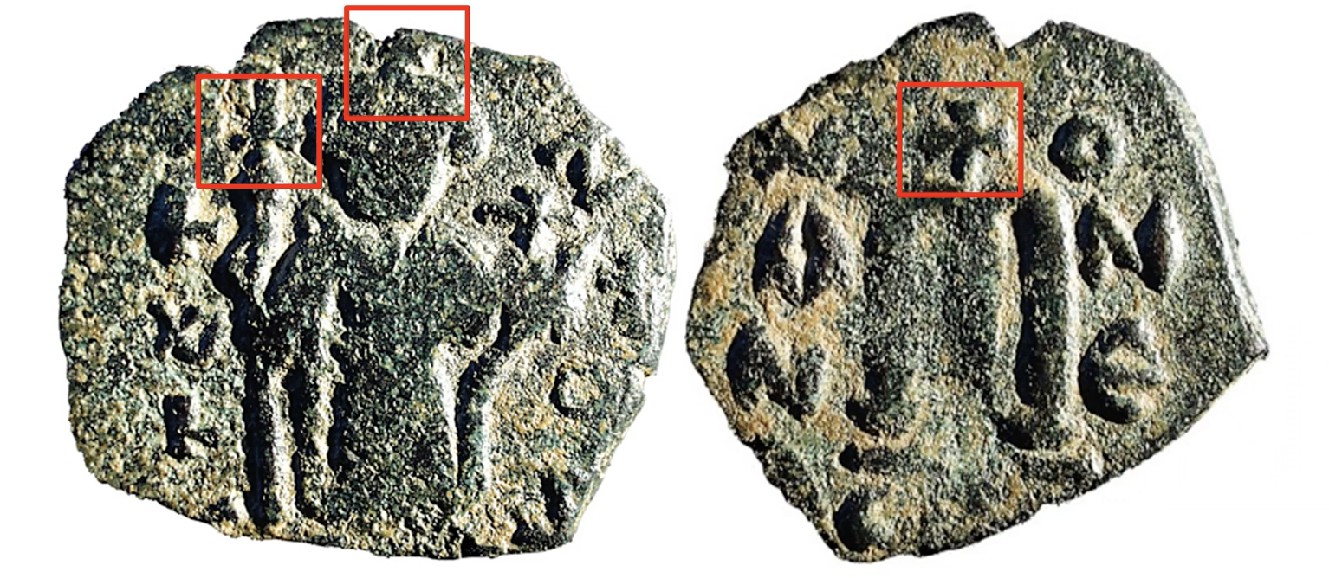
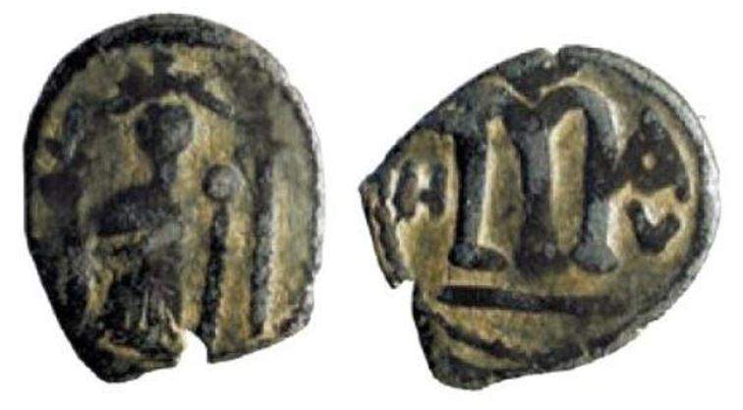
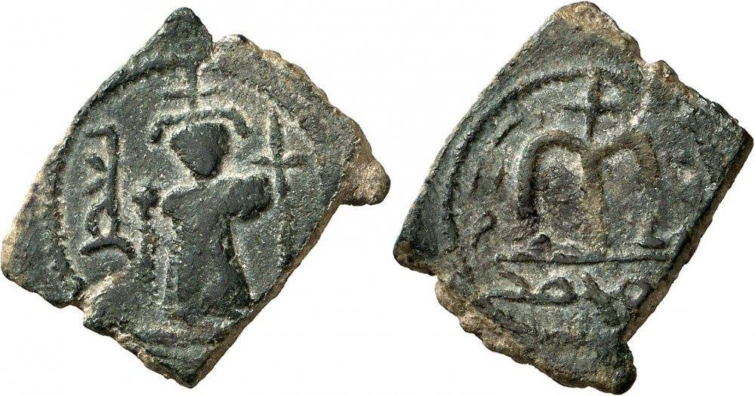
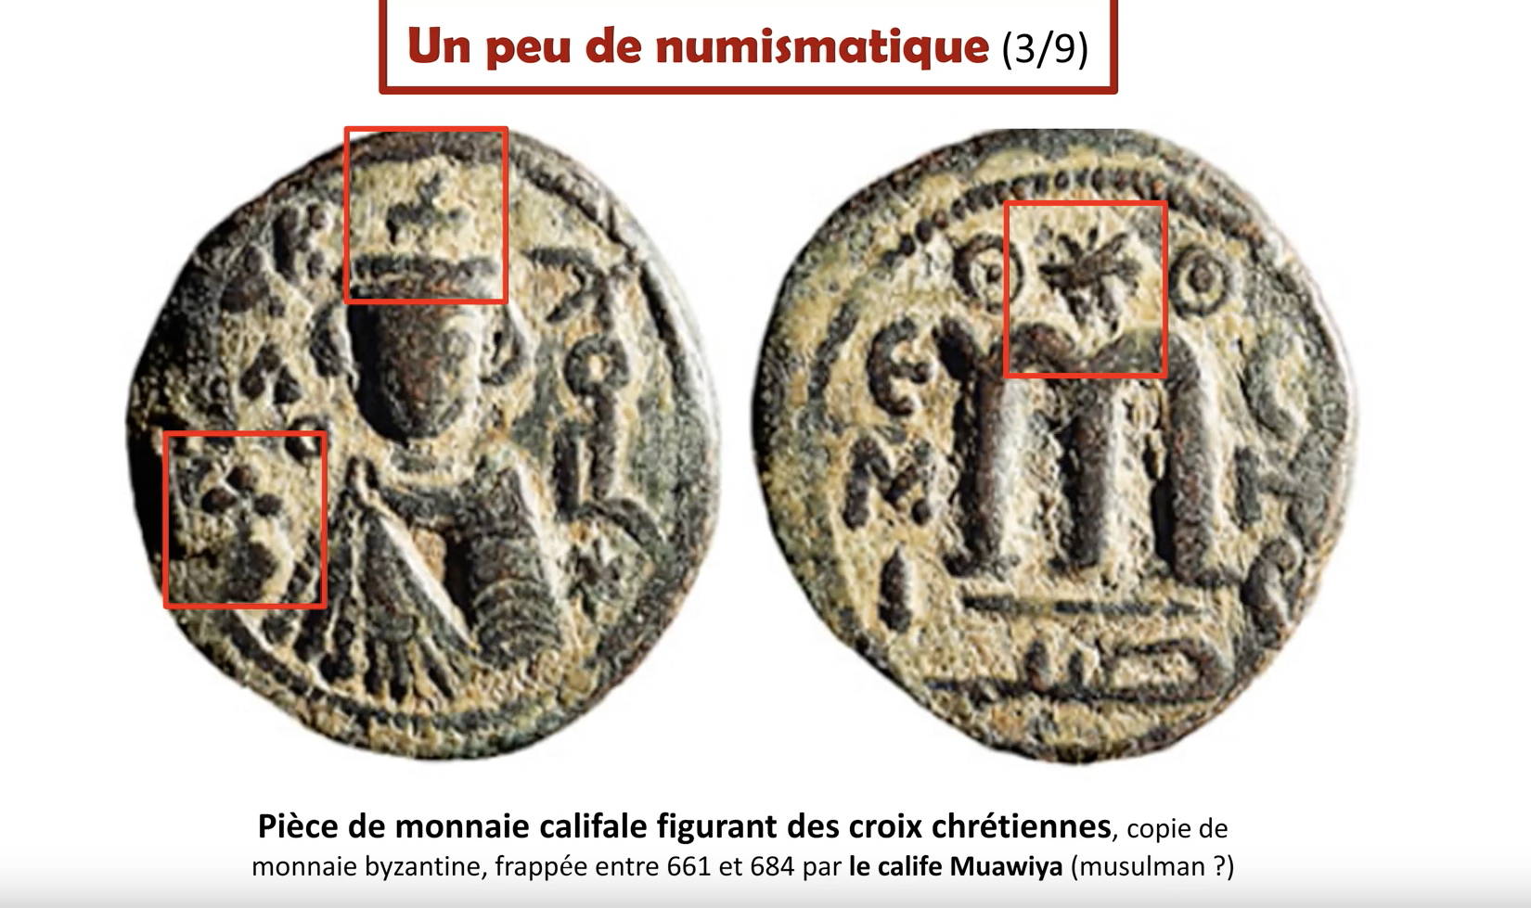
USING A TIMELINE TELLS THE STORY – 7TH CENTURY NUMISMATICS
…632
651
661 - 680
692
693
696
Muhammad
Sassanian
Mu’awiyah
Abd al-Malik
Abd al-Malik
Abd al-Malik
Dies, but no ‘Islamic’ coins exist during his time, nor during the entire Rashidun period (624 – 661 AD)
Empire
Ceases, yet the Arab coins are Christian, up to 661 AD, and all the coins are minted too far north
The first Caliph of the Umayyad Empire, mints coins with Christian crosses in the West, & Zoroastrian fire altars in the East, up to 680 AD, still nothing Islamic
Mints (possibly) the 1st Islamic Coin! It includes the ‘Shahada’, and is widely used, though it causes a war
Mints a coin with his image & a sword, & that he is the ‘servant of Allah’
Mints a coin with no image, with references attacking Christianity
The text is introduced by a Christian cross and refers to Muawiya as ΑΒΔΑΛΛΑ ('abdalla') and ΑΜΗΡΑΑΛΜΥΜΕΝΗΝ (‘ameraalmoumenhene'), direct transliterations into the Greek alphabet of the Arabic expressions abd allah and amir al-mu'minin, "servant of God" and "commander of the believers

Slide 37



Note where the 7th c. rock Inscriptions are found
Early Arabic Rock Inscriptions
Jordan, Syria
The 7th century inscriptions are all in the north, and the south
A few begin to appear in the Hijaz in the 8th century, and later
Yemen

Slide 38
The Rock Inscriptions give us a timeline of Islam’s Origins
Ilkka Lindstedt’s 100 dated Rock Inscriptions
640 - 740
Lindstedt looked at 100 Rock Inscriptions from 640 – 740 AD
Prior to 690 there was no evidence of anything Islamic on the Inscriptions
Except for formulae, everything comes after 690
690
690 – 710 [Prophet Muhammad appears]
690
710 – 720 [Muslim rites appear]
[Pilgrimage, Prayer, Fast]
[Pre-690
Pious Formulae]
720 - 730 [The names ‘Muslim’
& ‘Islam refer to a specific group,
in contradistinction to
Christianity]
Conclusion: It was only in the 730s onwards that there is evidence of popular devotion to Muhammad as a prophet and messenger, which makes the Islamic Traditions incredibly awkward.
570
585
600
615
630
620
630
645
660
675
690
715
730
745
760
775
Furthermore: There is a 100-year silence prior to this that indicates that Islam did not exist as a distinct religion until
long after the time of Muhammad, which casts doubt on whether he had any part in starting Islam.
[Ilkka Lindstedt, “Who is in, who is out? Early Muslim Identity through Epigraphy and Theory”, 2019]

Slide 39
FINAL CONCLUSIONS ON ISLAM’S ORIGINS
Only using evidence from the 7th – 8th centuries

Slide 40
FINAL CONCLUSIONS
Our Remit was to investigate both the Mecca, Muhammad, and the Qur’an (later on)
Sources: It is obvious that everything Muslims are dependent on for their ‘book, man and place’ are based on Traditions (SIN) which are 200 – 300 years too late, and 100s of miles too far north
Mecca proves probably the biggest problem for Muslims
  The SIN refers to a place with much vegetation, existing since Adam & Eve, & with 300 prophets buried
  Yet, it’s not referred to until 741 AD, and none of the early maps show Mecca at all
  Patricia Crone debunked Watt’s land based ‘Trade-Route Theory’ going through it back in 1987
  We debunked the Red Sea Trade via Arabia, proving it was all via Africa, because it had water
  All of the 7th century Qiblas were facing Petra up to 706 AD, and not Mecca until 729 AD
  None of the surrounding empires ever heard of the Mecca
  All of the stages of the Hajj were simply borrowed from other places, mostly Jerusalem

Slide 41
FINAL CONCLUSIONS
Origins: The coins prove that the area under “Islam” was either Christian or Zoroastrian until 692 AD
The Rock inscriptions prove that Islam as we know it didn’t appear until around 730 AD
Overview: The 7th – 8th century Arabs in order to create their own distinct identity needed a ‘book, a man, and a place’, which they did with the Qur’an, Muhammad and Mecca; but it didn’t take just 22 years as the SIN claims, but centuries, proving that Islam is as man-made as any other religion, unlike Christianity!
We can use this material today to disprove the Preservation of Muhammad and Mecca (and later the Qur’an)
It is Islam and not us who are ‘arguing from silence’, as we have the 7th c. evidence they don’t have
These arguments hit at the very foundations of Islam; yet they are neutral and ‘politically correct’
Thus, anyone can use them, but really we must use them, because we are the only ones who have an answer, an antidote, and the only alternative…Jesus Christ!

Slide 42
Yet, by Casting Doubt on Islam
Our Muslim Friends can Consider a Better Book, and a better Man…Jesus, and His Gospel.
So, let’s “bring them home”!

